Slide 1
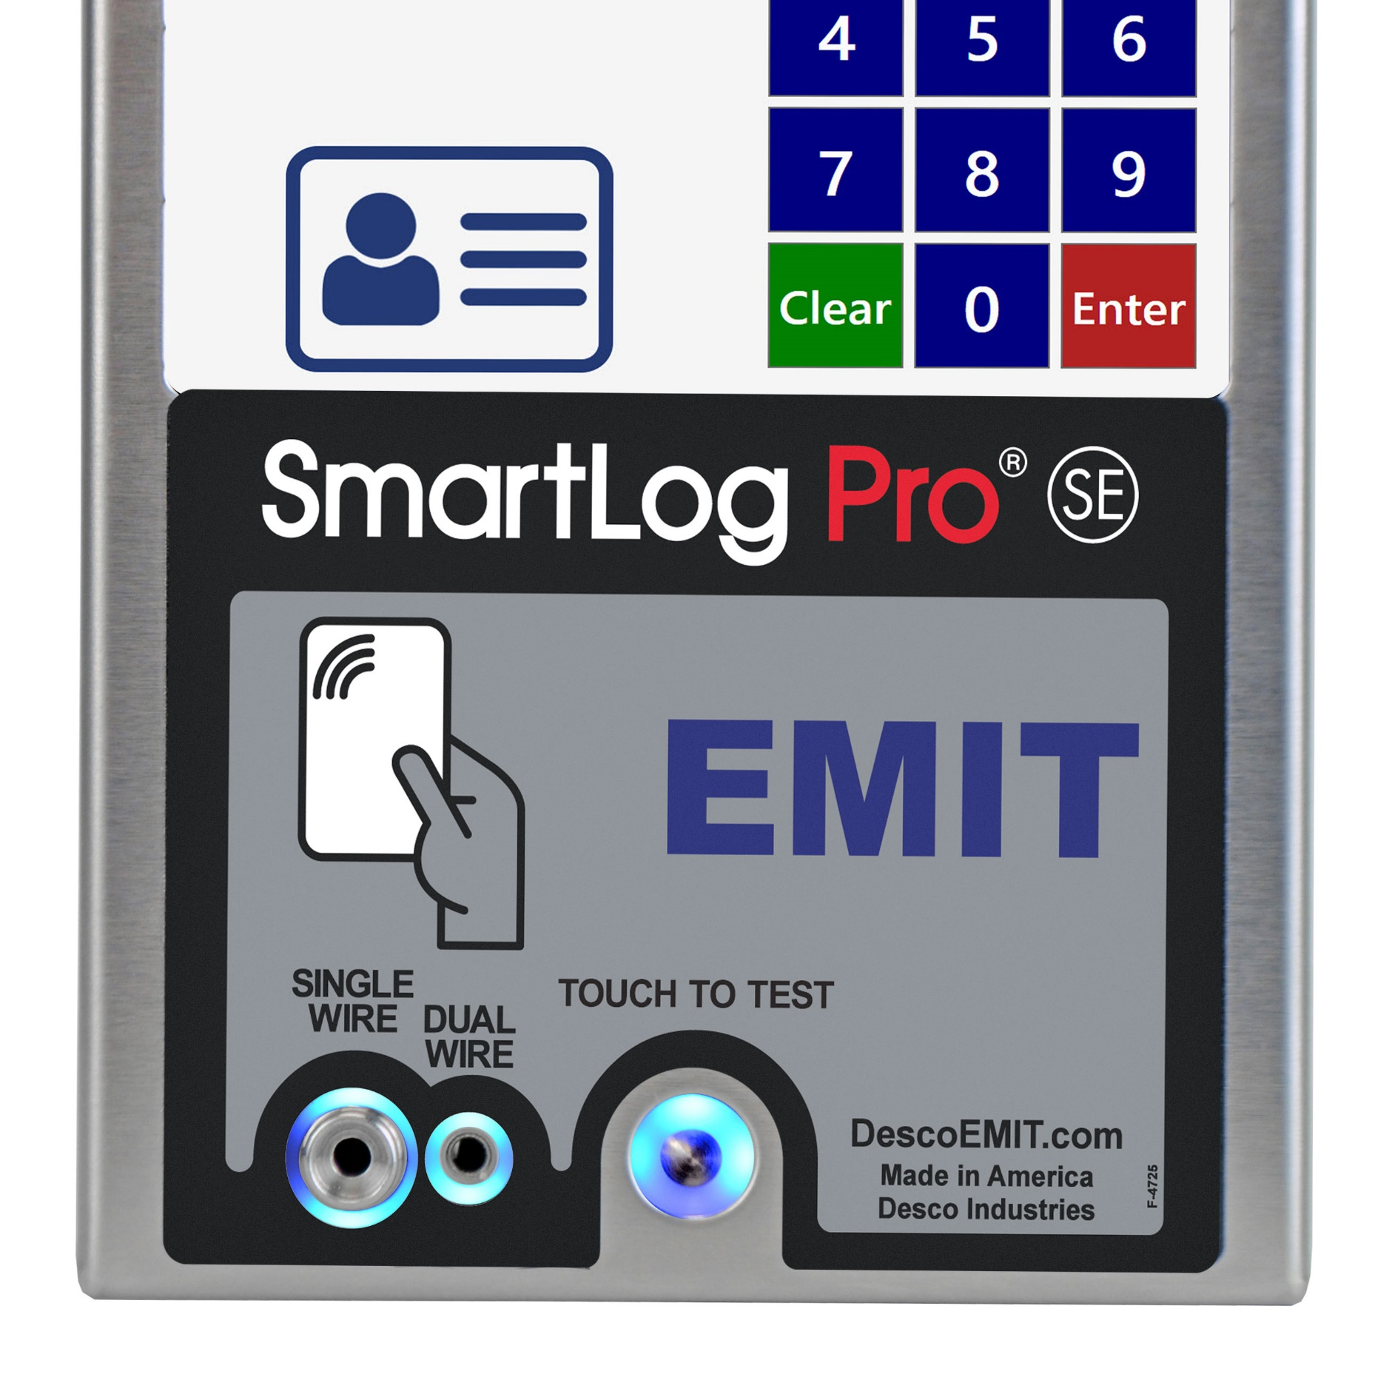
SmartLog Pro® SE
ESD Results at your Fingertips
© 2021 DESCO INDUSTRIES INC

Slide 2
The SmartLog Pro® SE verifies the functionality of an operator’s wrist strap and footwear, logs the test record, and controls access to an ESD Protected Area.
All operator test activity is logged into a database to meet the IEC 61340-5-1 requirement for “Compliance verification records shall be established and maintained” and for on-going quality control purposes.
Each log entry includes operator identification, test results, resistance measurements, time, temperature and humidity.
Operator identification and access control is performed using the embedded HID OMNIKEY® proximity reader, barcode reader or touchscreen keypad.
Access control to an ESD Protected Area can be further enforced by using the relay terminal on the SmartLog Pro® SE. It can be connected to an electronic door lock or turnstile to grant access only to those who have passed their pre-defined ESD tests.
DescoEurope.com

Slide 3
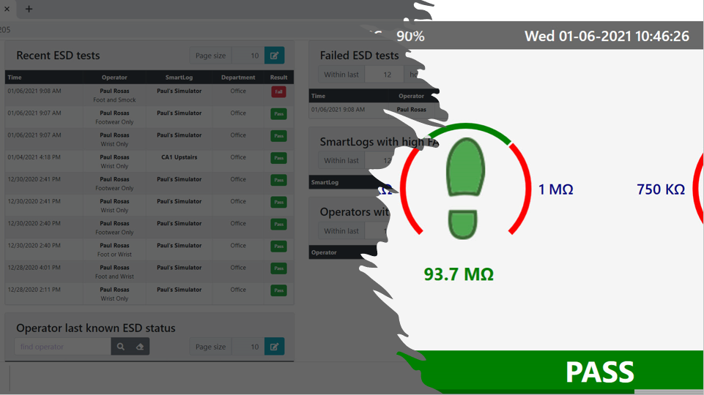
Daily Operator Testing
Transactions Logged in Server Software
Daily ESD Reports
Process Validation
DescoEurope.com

Slide 4
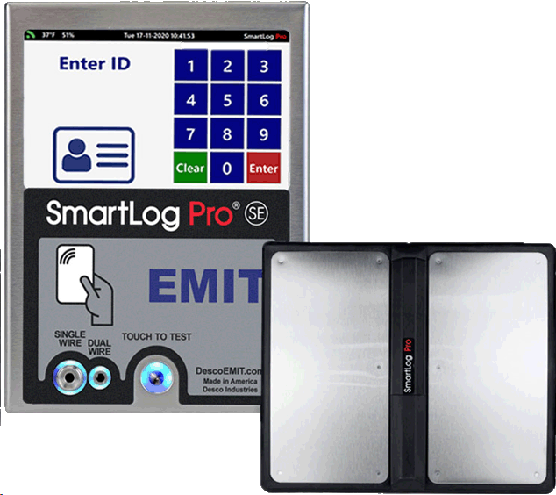
Internal Data Storage
Digital Numeric Keypad
5-inch Colour Touch Screen Display
Embedded CCD Barcode Scanner
Dual Foot Plate for Independent Footwear Testing
HID OMNIKEY Proximity Reader
Single-wire and Dual-wire Testing
Solid State Touch Switch
Optional Contactless
Test Fixture
DescoEurope.com

Slide 5
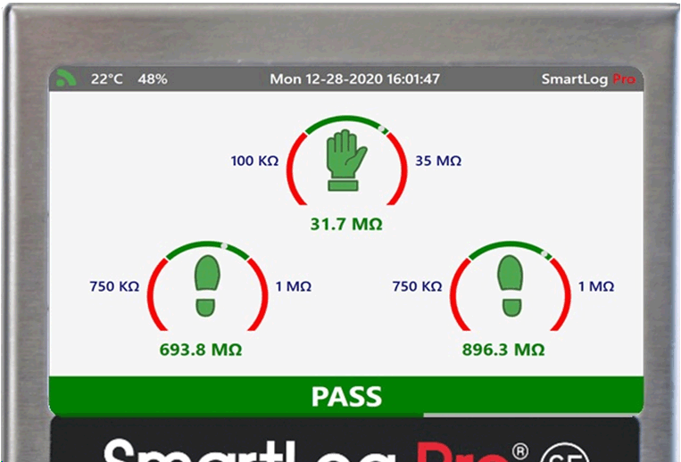
Temperature and Humidity Values (°C or °F)
Time and Date
Network Status Icon
Dedicated Test Icons
(Wrist / Foot / Smock)
Measured Resistance of Each Test
(kΩ / MΩ / GΩ)
Adjustable Test Limits
Colour Coded Test Results
(Green = Pass / Red = Fail)
DescoEurope.com

Slide 6
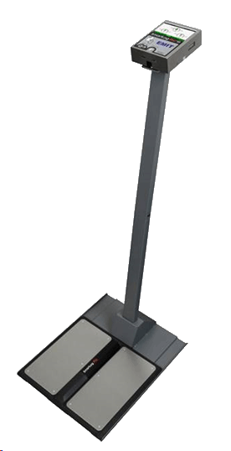
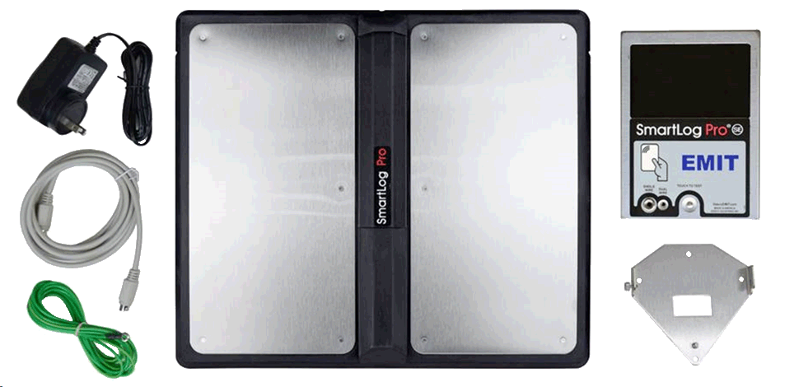
Optional Stand
Available
SmartLog Pro® SE
Mounting Bracket
Dual Independent Foot Plate
Power Adapter and Cabling
DescoEurope.com

Slide 7
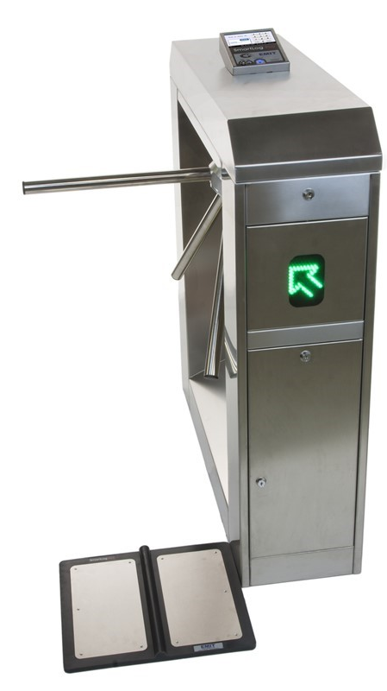
The EMIT SmartLog Pro® SE with Turnstile controls access to the ESD Protected Area to operators that have passed their pre-defined ESD tests and have been granted access to the area.
Turnstile functionality and operator access may be managed using the SmartLog Pro® Manager Web App.
Access Features:
Control access to the ESD Protected Area
Records operator access and ESD test results
Restrict access by department, shift, or specific notation
Key Turnstile Features:
Motorised arm rotation
Field configurable for single direction or bi-directional operation
Configurable with pre-existing fire and safety systems
DescoEurope.com

Slide 8
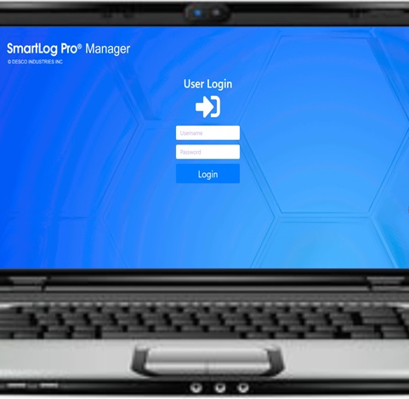
SmartLog Pro® Manager
Web App
DescoEurope.com

Slide 9
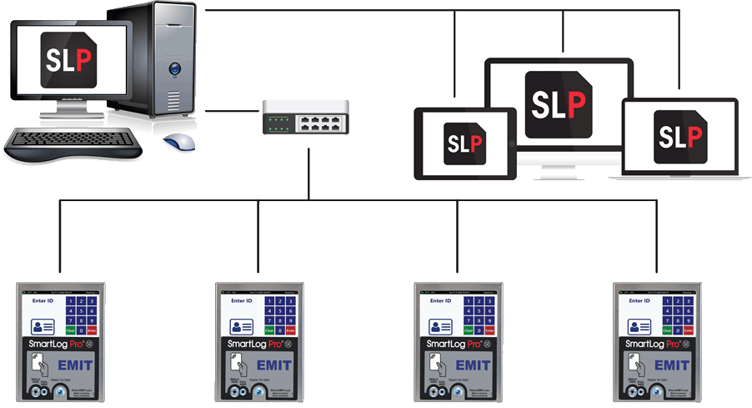
Use SmartLog Pro® Manager to meet the IEC 61340-5-1 requirements for an ESD Control Plan. The app is installed onto one server and accessed via a web browser. Each log entry includes operator identification, test results, resistance measurements, time, temperature, and humidity.
SmartLog Pro® Manager API
Hosted on Microsoft Windows Machine
Manager uses API services to expose full functionality to client applications.
API services are highly optimized for speed and throughput.
Manager API runs in the background requiring no manual intervention
SmartLog Pro® Manager Web App
Accessed via web browsers
Manager Web App formatted for use on a PC, Laptop and Tablet
Compatible with Google Chrome, Firefox and Microsoft Edge
Real-time test results from all SmartLog Pro SE devices on the network
SmartLog Pro® SE
SmartLog Pro® SE
SmartLog Pro® SE
SmartLog Pro® SE
DescoEurope.com

Slide 10
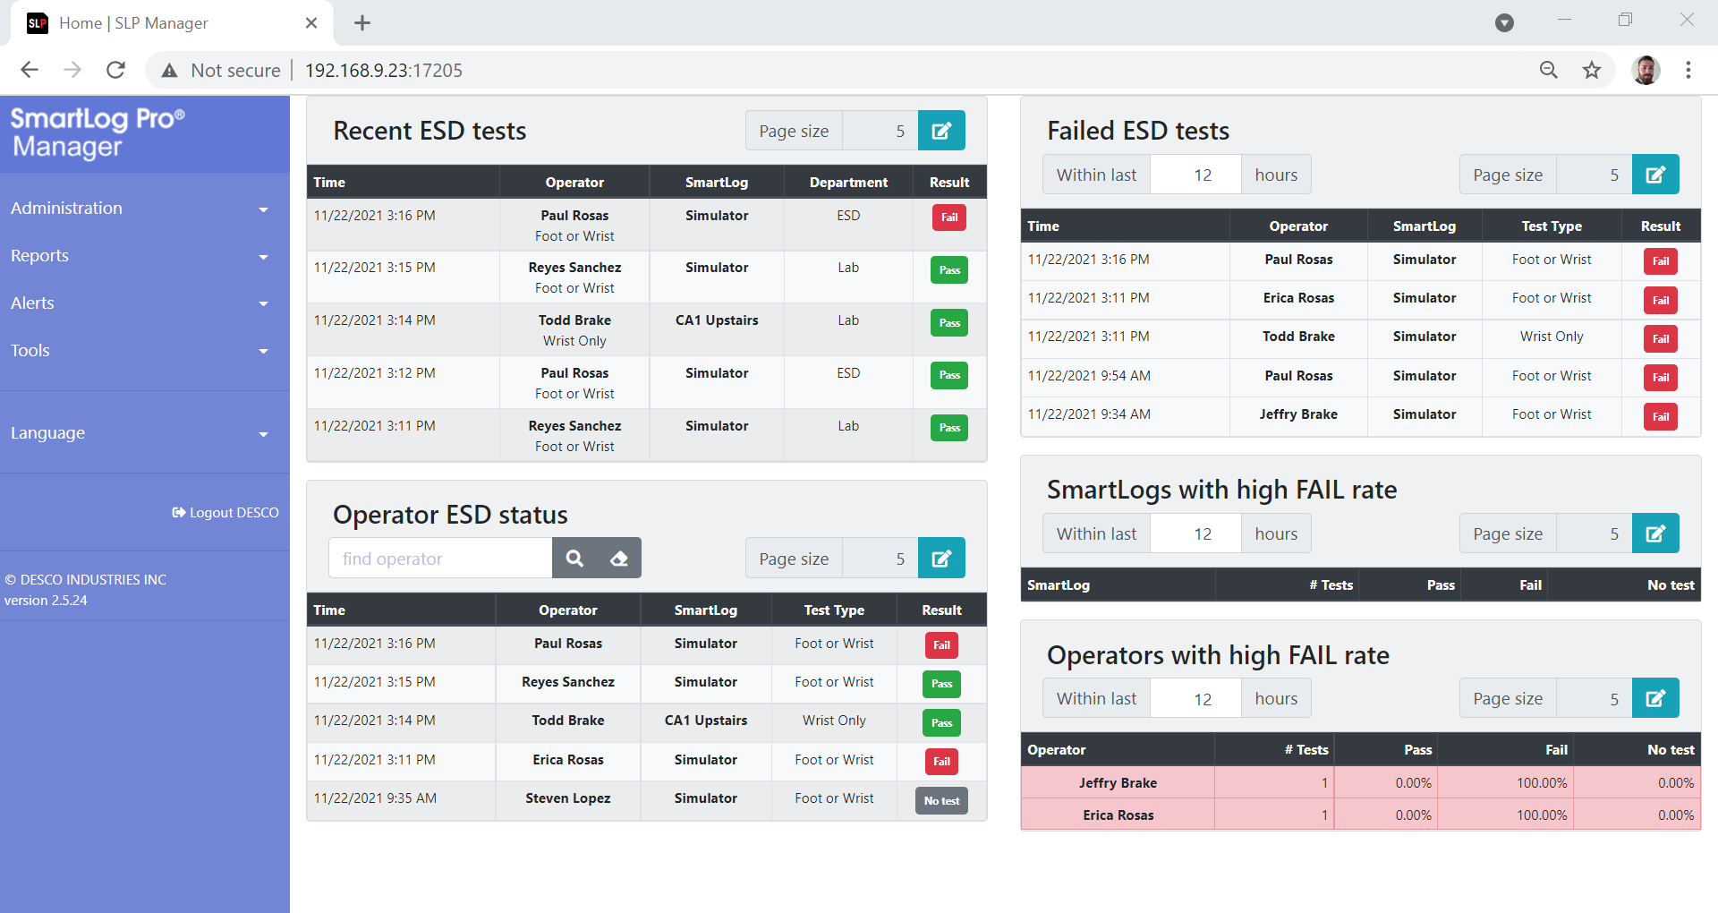
ESD Dashboard
Real-time ESD results from all SmartLog Pro SE’s
Current ESD Status of each Operator
Accessible from any PC/Laptop/Tablet on the network
DescoEurope.com

Slide 11
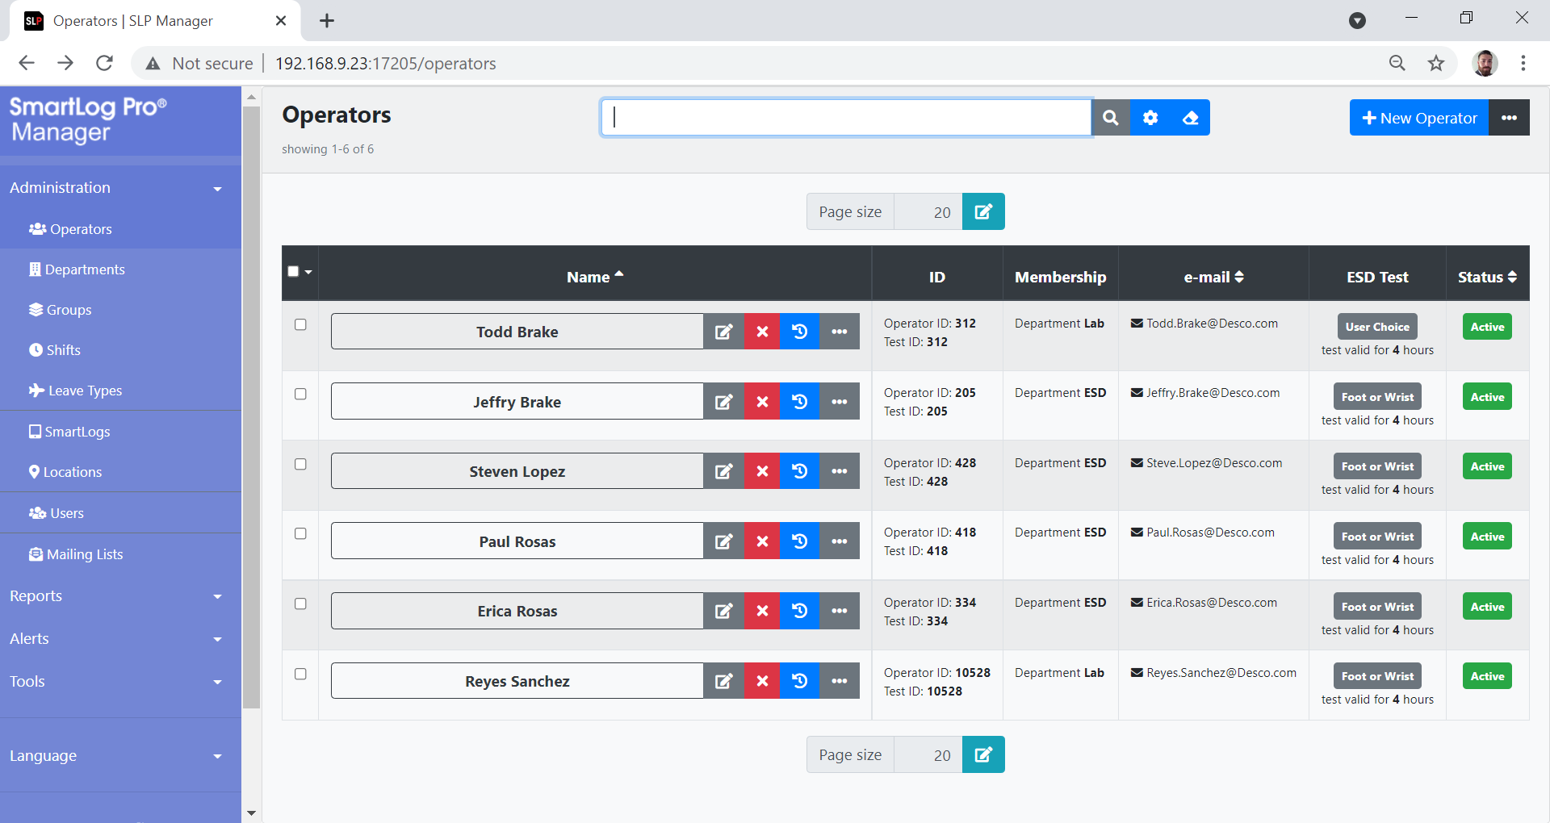
Operator Management
Manage operators daily testing requirements, shifts, leave times, etc.
Auto operator import capabilities
Visitor/Temp operator profile feature
DescoEurope.com

Slide 12
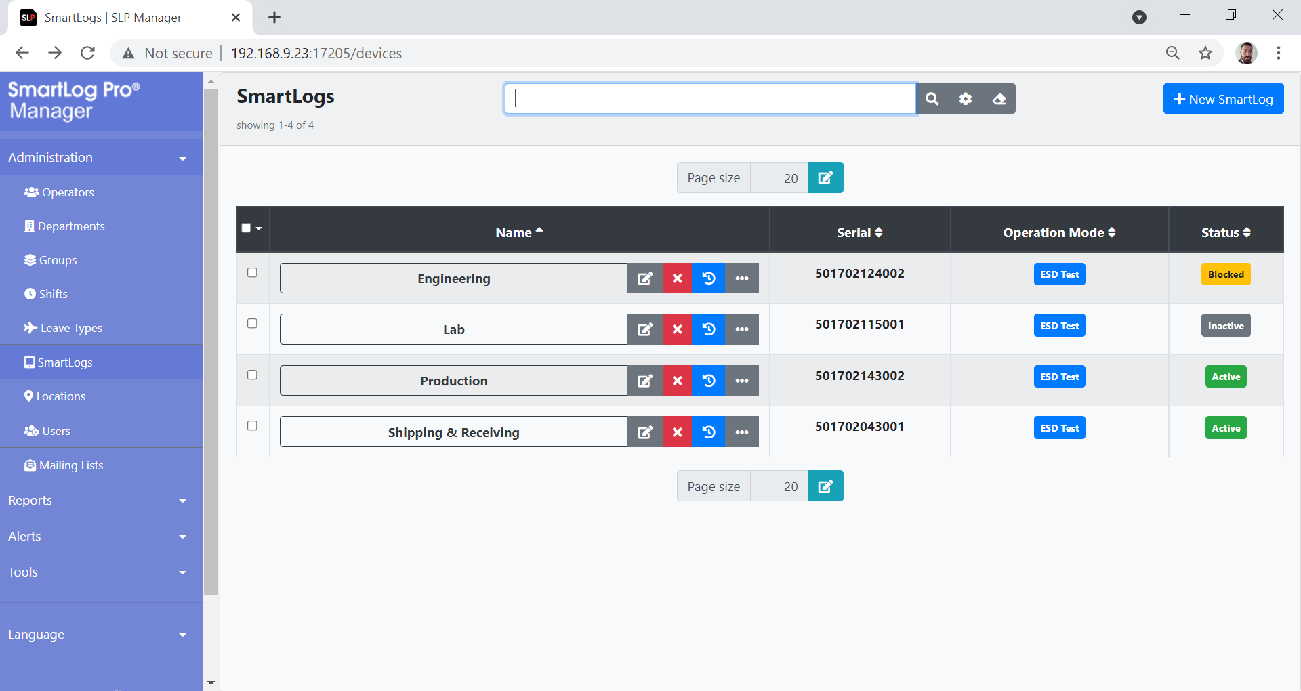
SmartLog Management
Monitor and manage activity of all SmartLog Pro SE’s on the network
Color coded status indicators of each SmartLog Pro SE
Various operation modes available including ESD Test, Time Clock and Access Control
DescoEurope.com

Slide 13
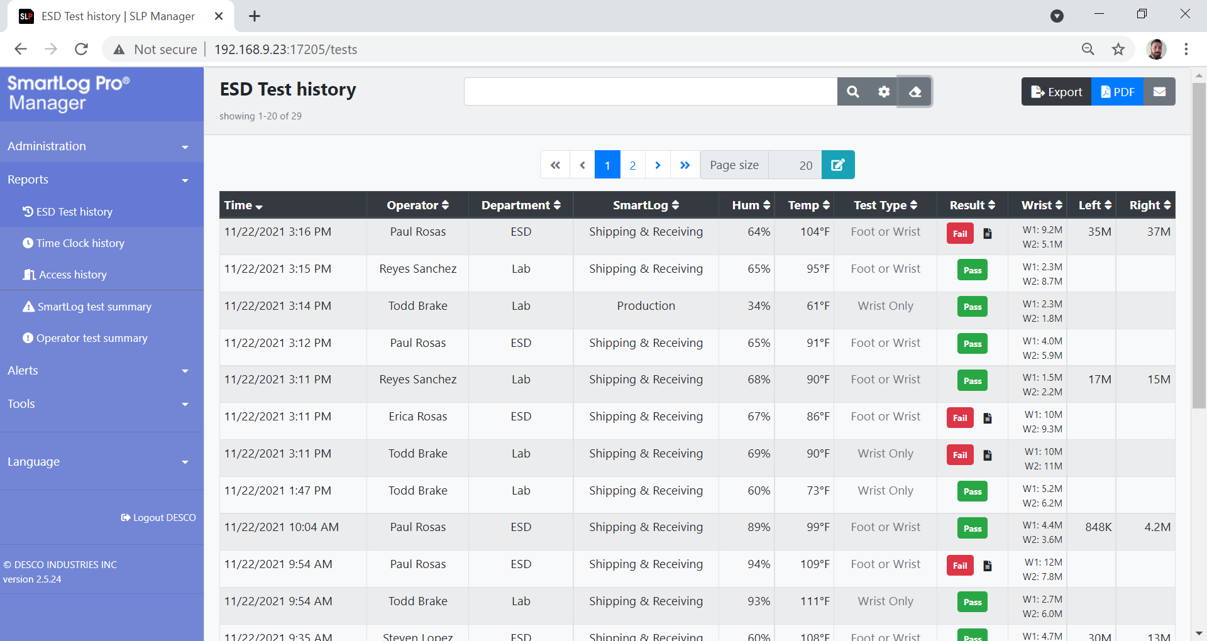
ESD Test History
Real-time results of current and past ESD transactions
Filter results by Operator, Department, Result, etc.
Fault notepad feature for documenting failed tests

Slide 14
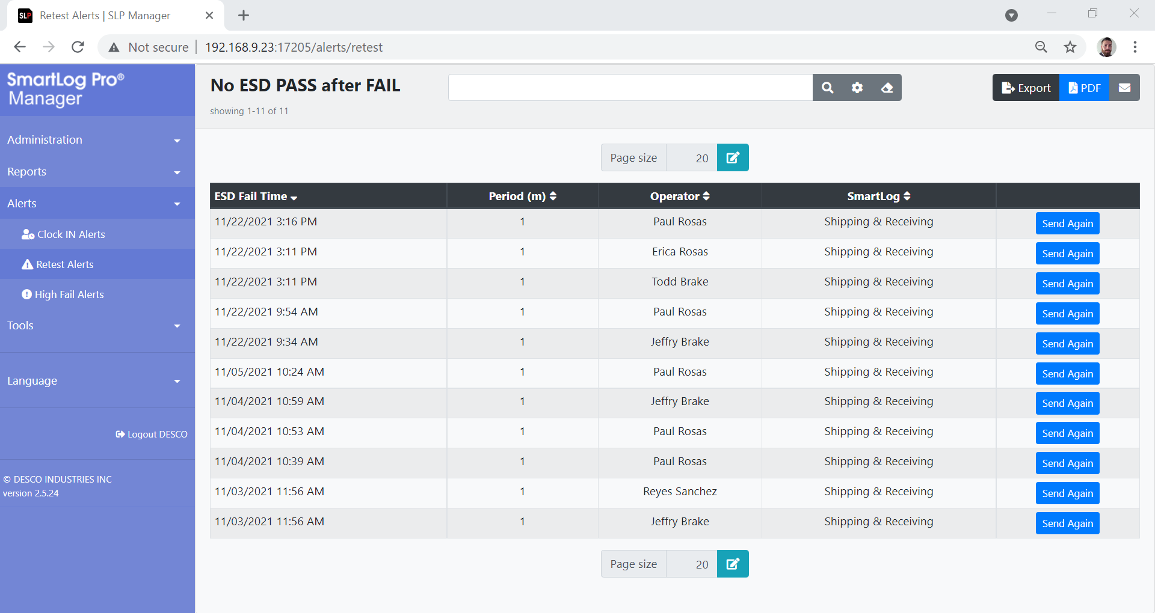
Alerts
Preset emailed alerts notifying Supervisors of immediate failures
Controllable settings for each type of emailed alert
Current and Past reports of all Alerts sent
DescoEurope.com

Slide 15
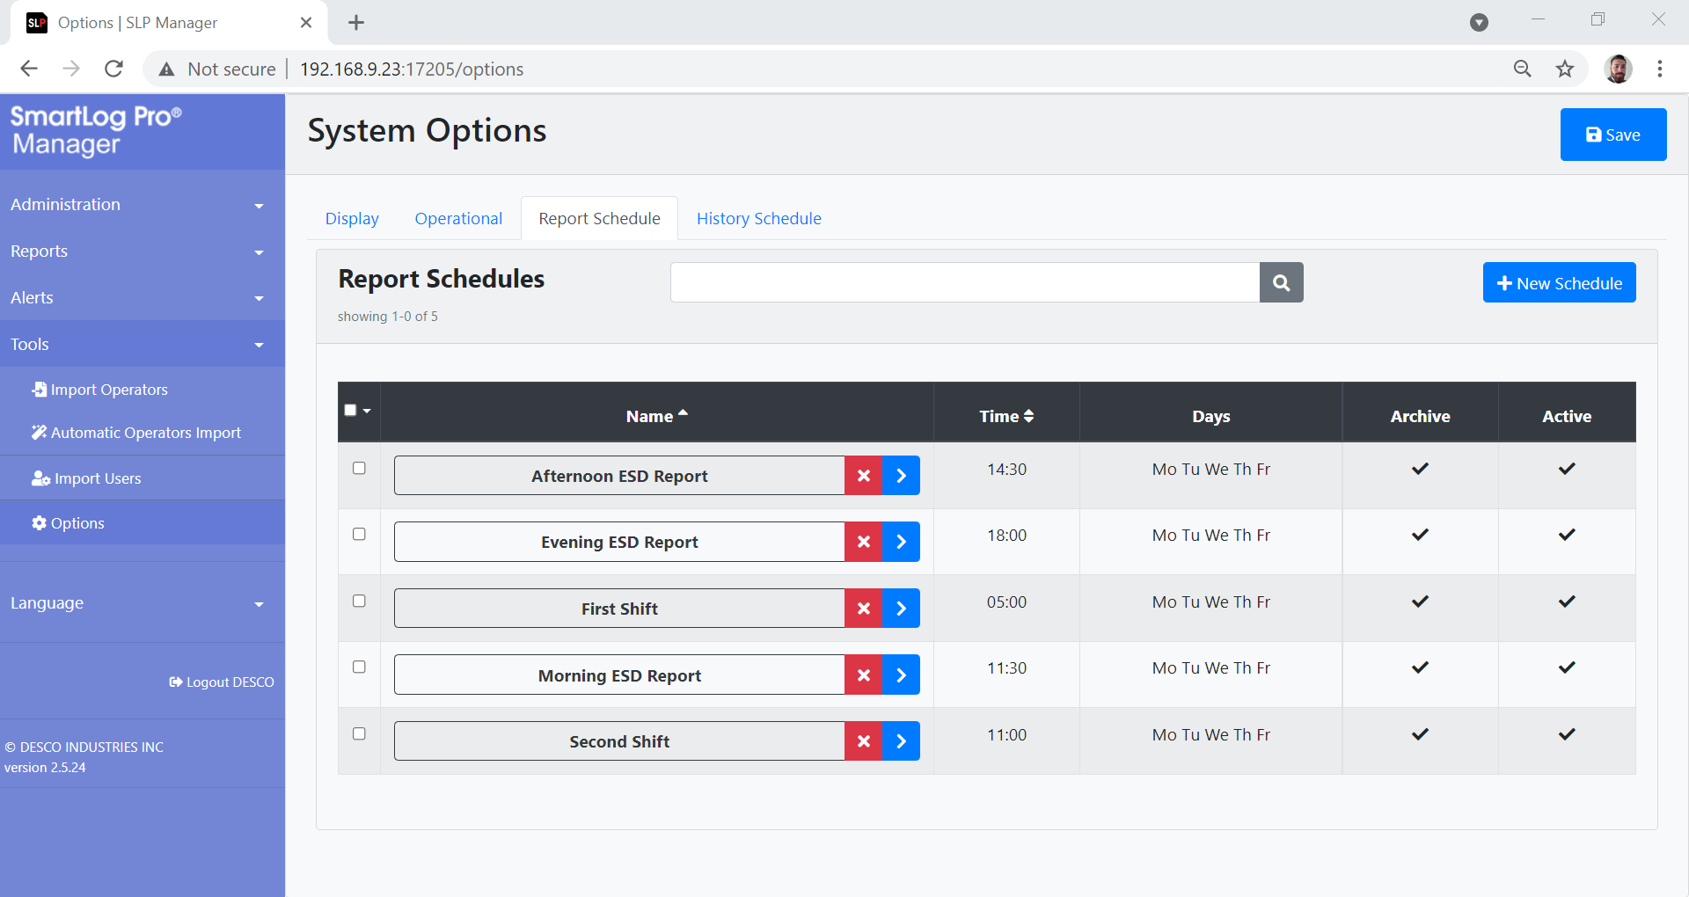
Emailed Reports
Schedule multiple ESD reports throughout the day/week
Filterable data by Operator, Result, Department, etc.
Archive feature allows copies of the reports to be saved for remote access
DescoEurope.com

Slide 16
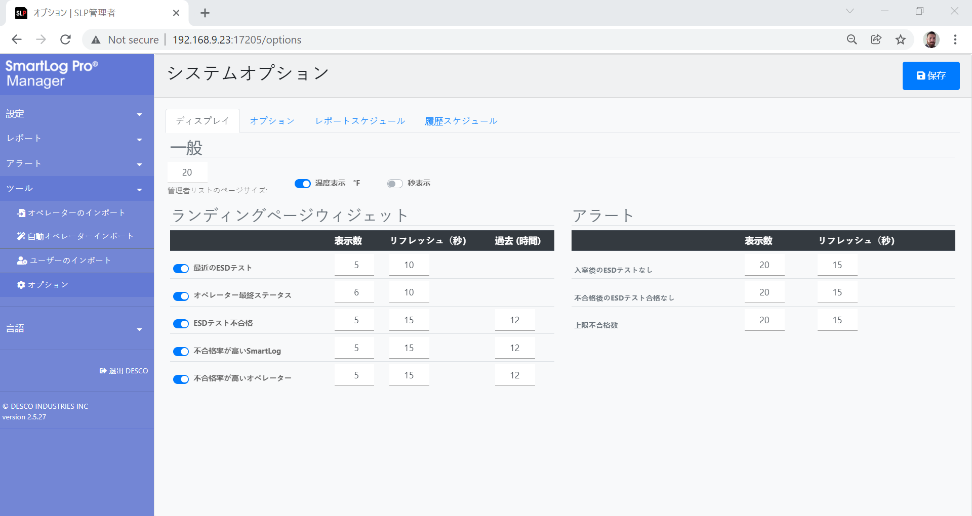
Languages
All language in Web Manager Software is translatable
Preset language options include Spanish, Japanese, French and more
Language on the SmartLog Pro SE can also be translated
DescoEurope.com

Slide 17
REQUEST A
DEMO TODAY!
DescoEurope.com

Slide 18
‌ ‌ ‌
For more information, please visit:
DescoEurope.com
2A Dunhams Lane
Letchworth Garden City
Hertfordshire, SG6 1BE, UK
Phone: +44 (0)1462 672005
Fax: +44 (0)1462 670440
Email: Service@DescoEurope.com

