Slide 1

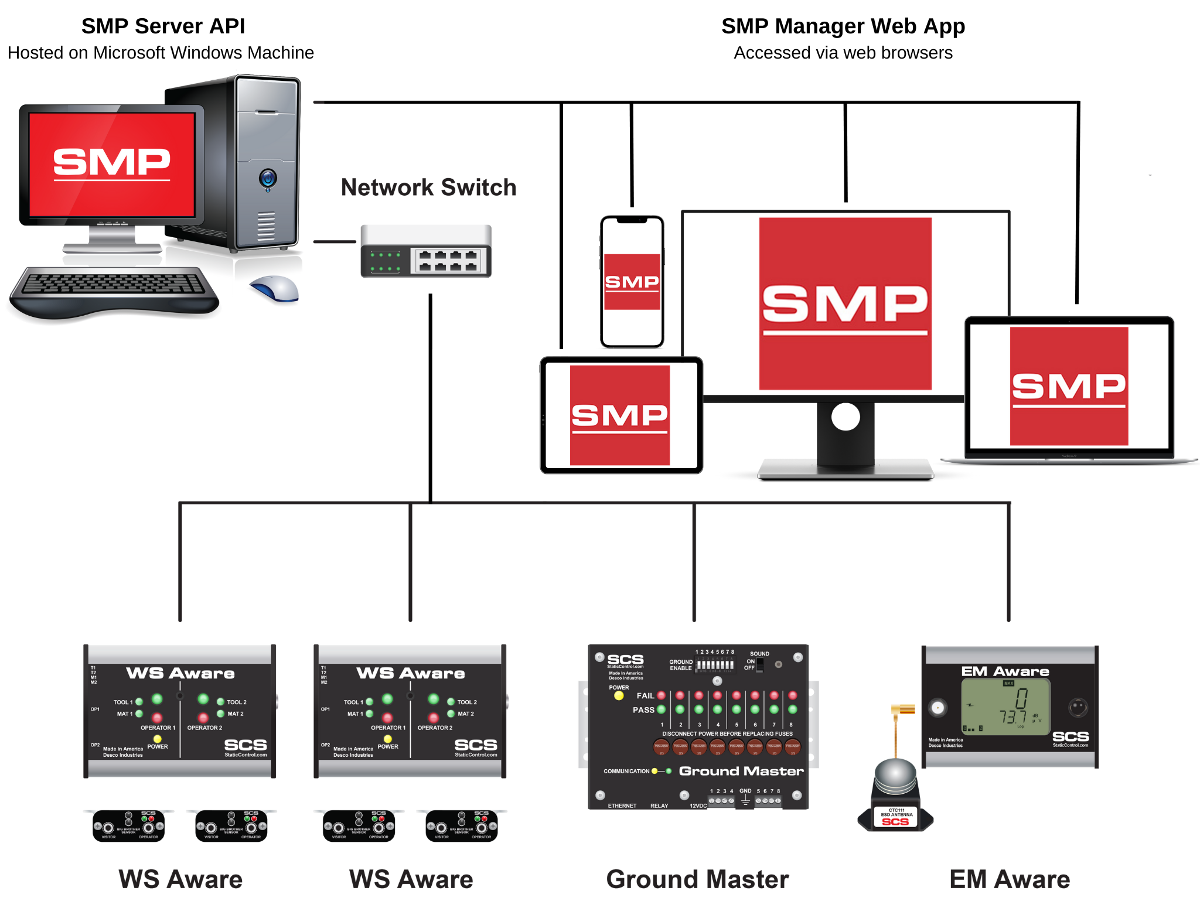


STATIC MANAGEMENT PROGRAM

Slide 2
STATE OF THE ESD INDUSTRY
Past
HBM (human body model) most prevalent failure mode
Current
CDM (charged device model) largest source of ESD issues
Future
Process control is inevitable. Customers will come to expect this.
S20.20 level of compliance sufficient for most operations
Must assure customers of ability to safely handle Class 0 components
Continuous monitoring is essential in high-reliability, high value environments
Critical to include SMT equipment
Diagnosing ESD problems can be challenging – data required
High levels of automation, ultra-sensitive components, and shop floor software will drive manufacturers to proactively manage their ESD initiatives
Compliance verification replaced by auditing data – inspections inadequate
DescoEurope.com

Slide 3
WHAT IS THE BEST SOLUTION?
System based on continuous detection in production areas
Equal attention to machine, bench and personnel monitoring
User-friendly tools for ESD coordinators who wear many hats
Ongoing readings at every stage where product could be damaged
Constant collection, reporting and analysis of data
Ability to demonstrate robust static control measures to customers
Transition away from reactive, fire-fighting approaches to proactive programs based on active management of entire ESD environment
DescoEurope.com

Slide 4

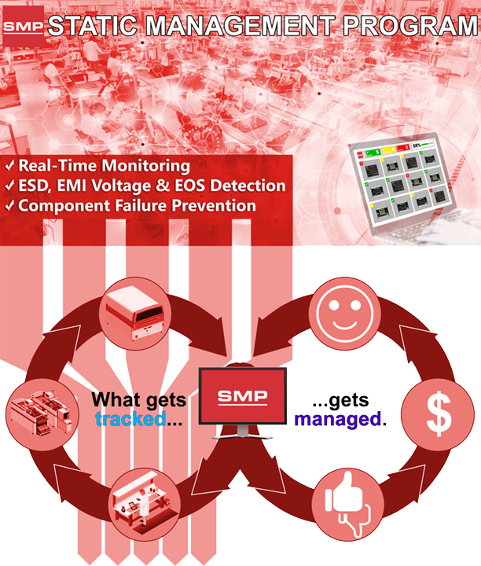




Static Management Program (SMP)
ELIMINATE
PAPER LOGS
PROCESS
EFFICIENCY
LATEST
TECHNOLOGY
PROGRAM
VALIDATION
Capture, record, and ﻿report on data
Find and measure ESD Events and EOS
Prevent component failures
Reduce losses due to ESD, EMI Voltage and EOS
Increase yields and reduces rework
Increase customer satisfaction
DescoEurope.com

Slide 5

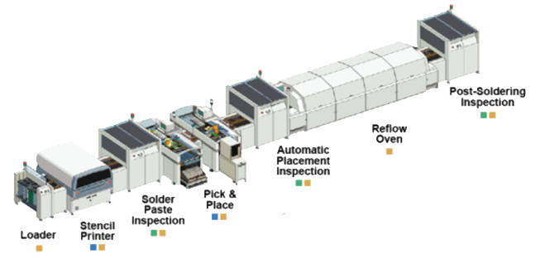
STATIC MANAGEMENT PROGRAM (SMP)
SCS Static Management Program (SMP) continuously monitors your ESD process control system throughout all stages of manufacturing. The SMP Software captures data from SCS workstation, equipment and ESD event continuous monitors and provides a real-time picture of critical manufacturing processes.
DescoEurope.com

Slide 6
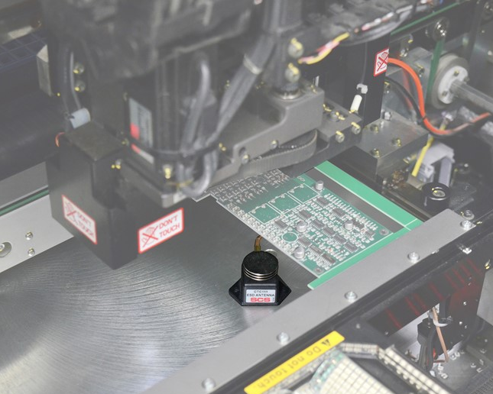
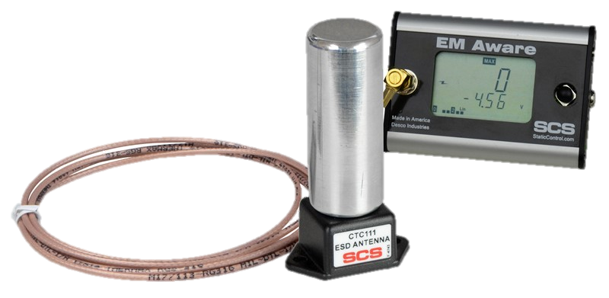
EM AWARE MONITOR
The EM Aware Monitor detects and measures electrostatic discharge (ESD) events, as well as static voltage and ionisation parameters (depending on the model).
The EM Aware Monitor is a continuous monitor with comprehensive diagnostics and troubleshooting features for use in an ESD environment.
Provides monitoring of critical ESD processes and is an instrument that can qualify tools for handling ESD-sensitive devices, making it an essential ESD management tool.
DescoEurope.com

Slide 7
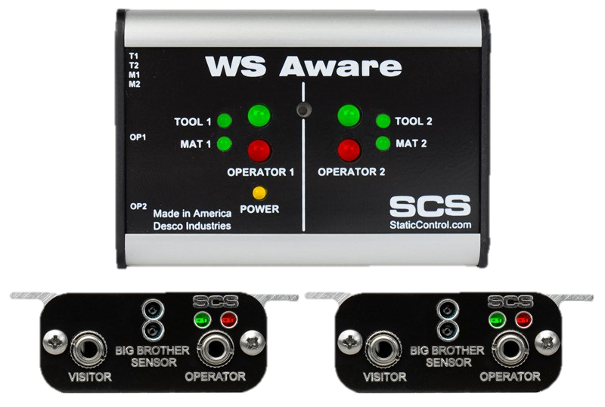
WS AWARE MONITOR
Continuously monitors all grounding parameters in full compliance with ANSI/ESD S20.20 in accordance with ESD TR1.0-01-01, as well as high-frequency noise (EMI) on ground.
It utilises dual wrist straps for a continuous resistivity check of human body connection. The monitor uses advanced digital signal processing technology for reliable monitoring with ultra-low control voltage.
Optional Big Brother remote terminals allow the monitor to alarm when an operator approaches static sensitive components but does not plug in his/her wrist strap properly.
Continuously monitors the path-to-ground integrity of two operators, two conductive or dissipative worksurfaces, and two metal tools
DescoEurope.com

Slide 8
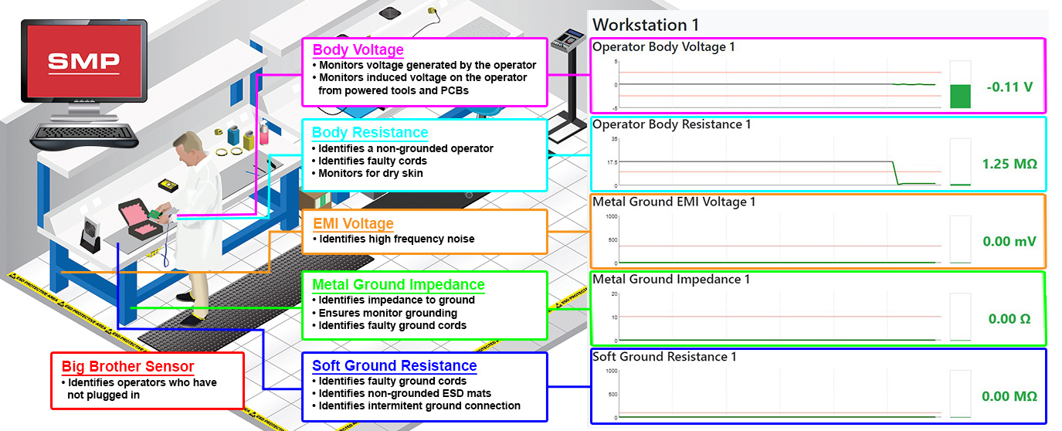
WS AWARE MONITOR
DescoEurope.com

Slide 9
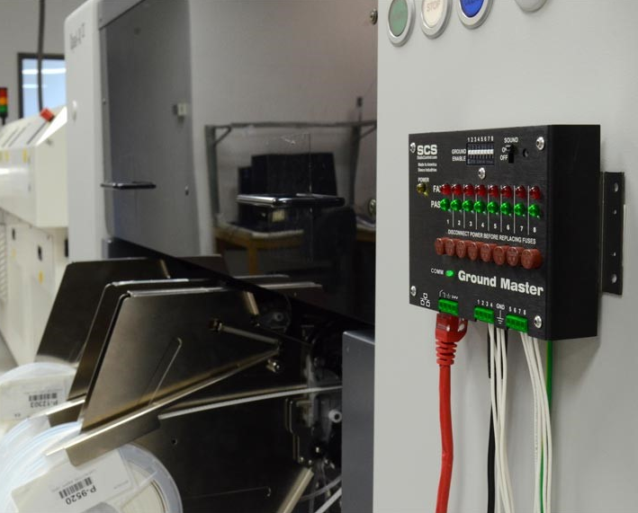
GROUND MASTER MONITOR
Ground Master Monitor is designed to provide continuous monitoring of proper ground connections of up to eight tools.
Ground Master Monitor measures impedance in accordance with ANSI/ESD S20.20
Ground Master Monitor also monitors EMI Voltage signals on each ground, to assist in diagnostics of equipment lockups and malfunctions.
Ground Master Monitor provides intelligent information to a facility monitoring system with detailed status on each ground connection.
DescoEurope.com

Slide 10
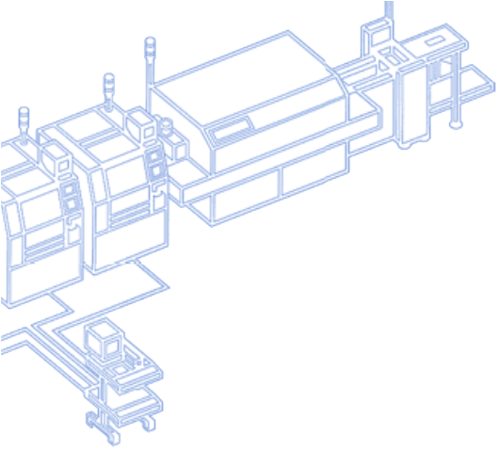
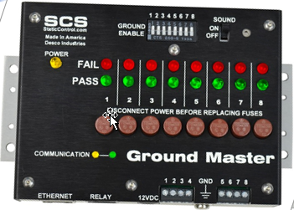

GROUND MASTER MONITOR
_{Wires to monitored}
_{tools}
_{Wires connected as shown}
Continuously Monitors Automated Tools
_{To SMP}
_{Reference Ground}
DescoEurope.com

Slide 11
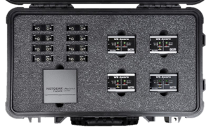
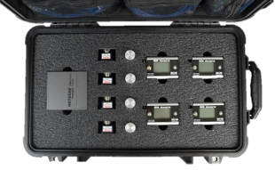
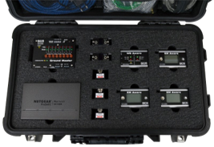
DIAGNOSTIC KITS
770050​ | 770051 ​ | 770052 ​
SMP Diagnostic Kit​ | ESD Event Diagnostic Kit​ | Workstation Diagnostic Kit​
​ | ​ | ​
Kit Includes:​ (1) 770121 SMP Software License​ (1) 770044 Ground Master Monitor​ (1) 770067 WS Aware Monitor​ (3) 770066 EM Aware Monitors​ (1) 8-Port Ethernet Switch ​ (6) CAT5E Cables​ | Kit Includes:​ (1) 770121 SMP Software License​ (4) 770066 EM Aware Monitors​ (1) 5-Port Ethernet Switch ​ (5) CAT5E Cables​ ​ | Kit Includes:​ (1) 770121 SMP Software License​ (4) 770067 WS Aware Monitors​ (1) 5-Port Ethernet Switch ​ (6) CAT5E Cables​ ​
DescoEurope.com

Slide 12

DescoEurope.com

Slide 13
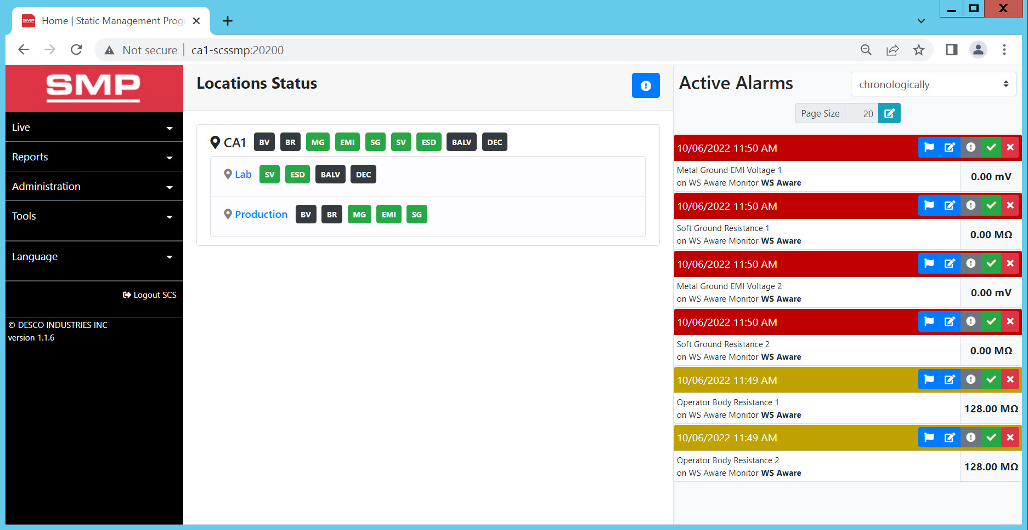
DASHBOARD
See the status of the entire facility clearly colour coded and organised by building, room and line. The entire table is hyperlinked, allowing a quick and easy drill down to rooms or even one line.
DescoEurope.com

Slide 14
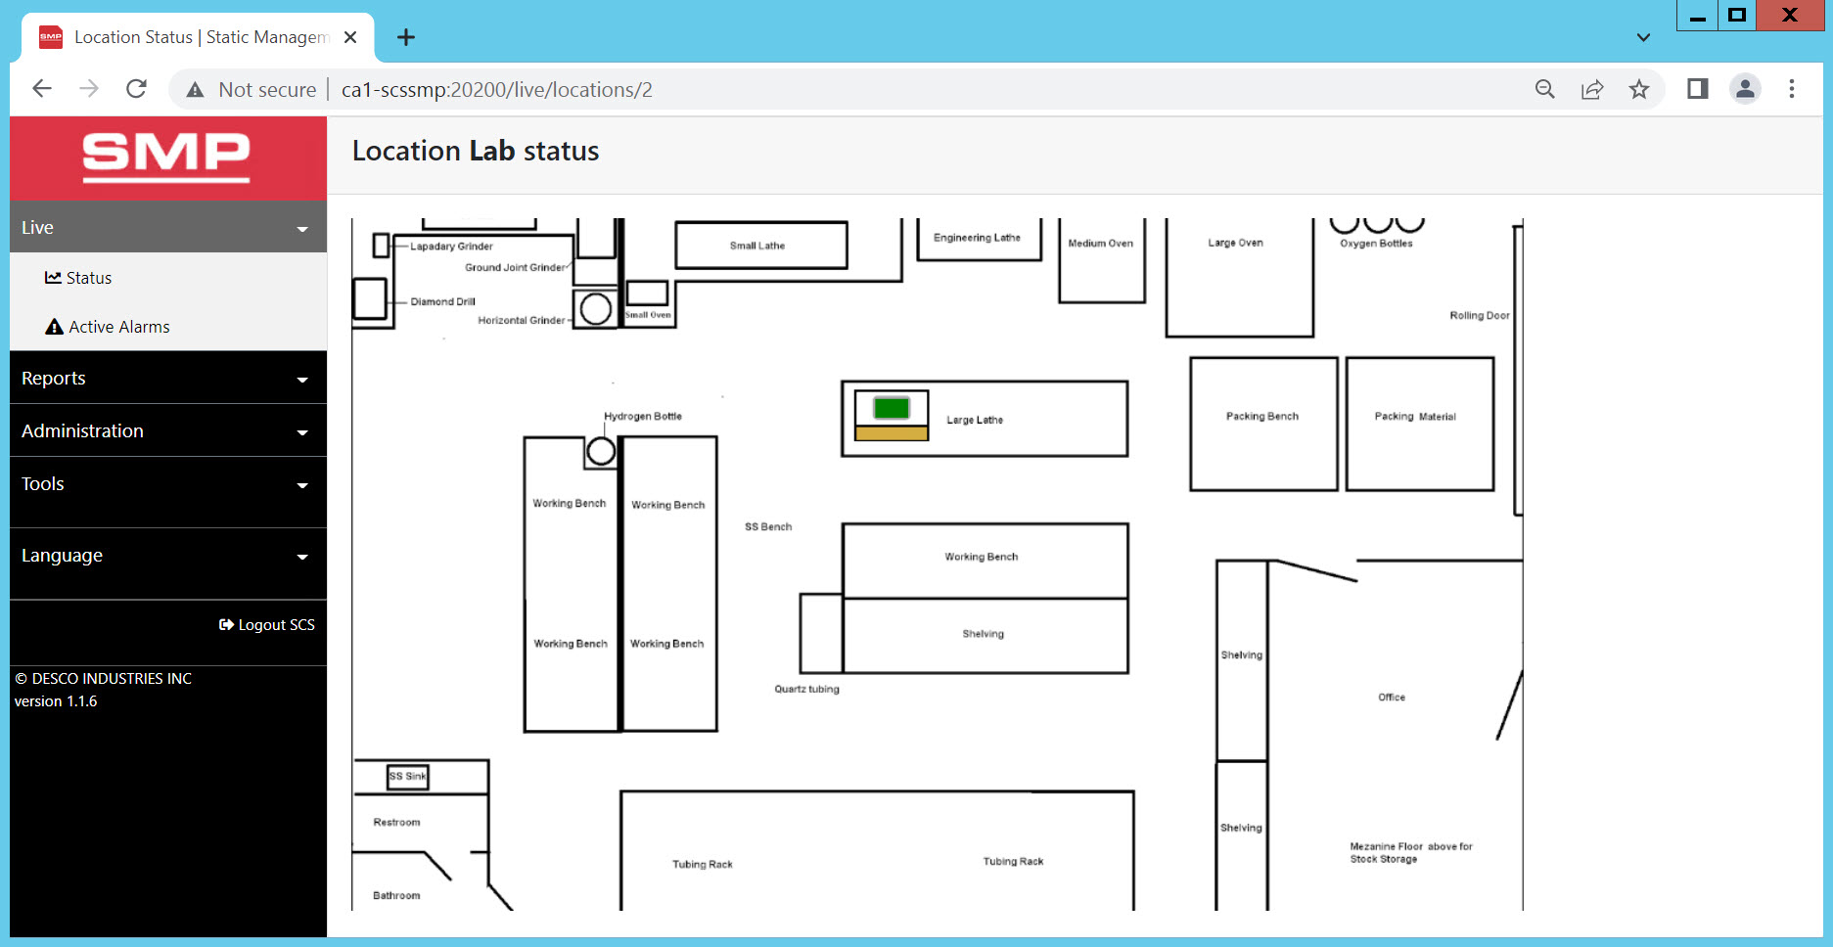
LAYOUT
A blueprint of the facility is uploaded and icons representing various SCS monitoring devices are placed in the appropriate positions. The monitors can be relocated without having to reimport the facility layout. The monitors are colour coded depending on status and hyperlinked to the individual devices.
DescoEurope.com

Slide 15
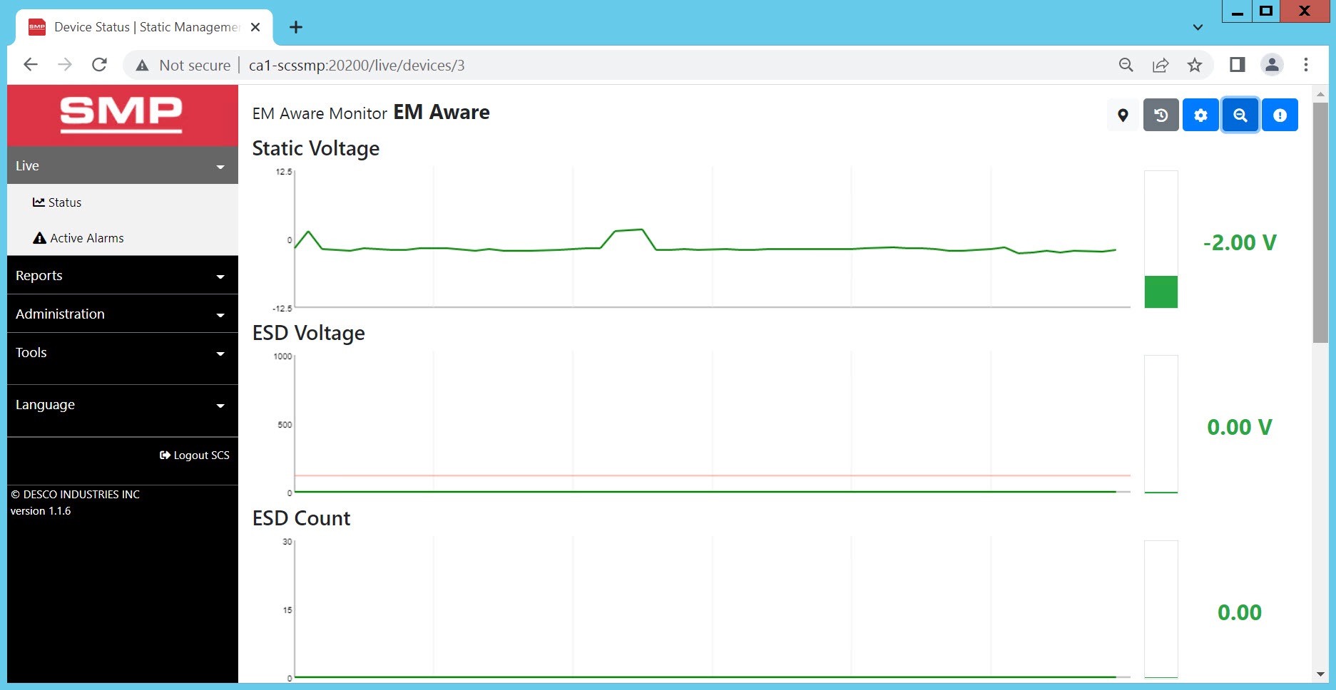
DEVICE VIEW
Continuously streams real-time information from a particular monitoring device and shows a list of recent alarms for the device
DescoEurope.com

Slide 16
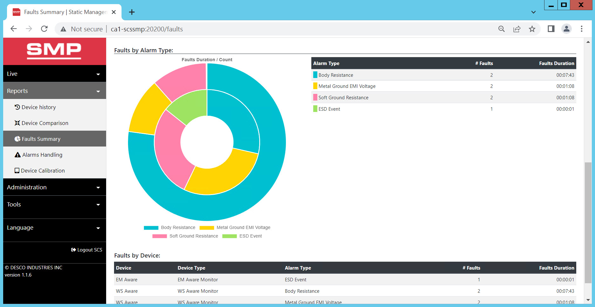
REPORTS VIEW
Summary reports show aggregate data for any area in the facility, over any specified time period. Faults are categorised by type and duration. All reports can NOW be printed to PDF or shared view email from the app.
DescoEurope.com

Slide 17
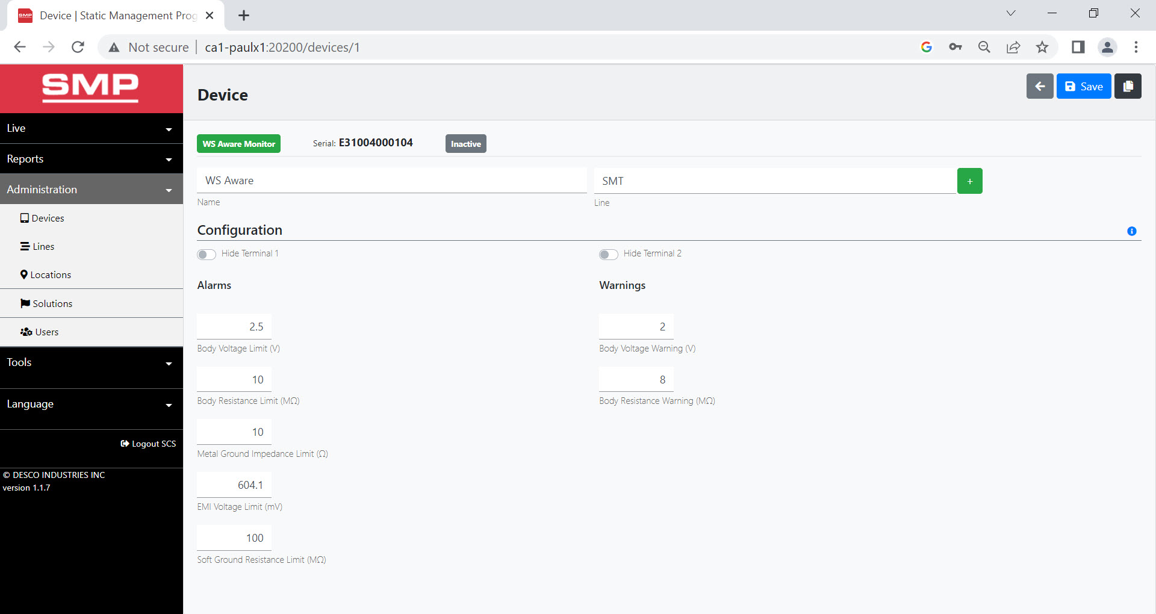
MONITOR CONFIGURATION
Remotely adjust monitor limits through the app
DescoEurope.com

Slide 18
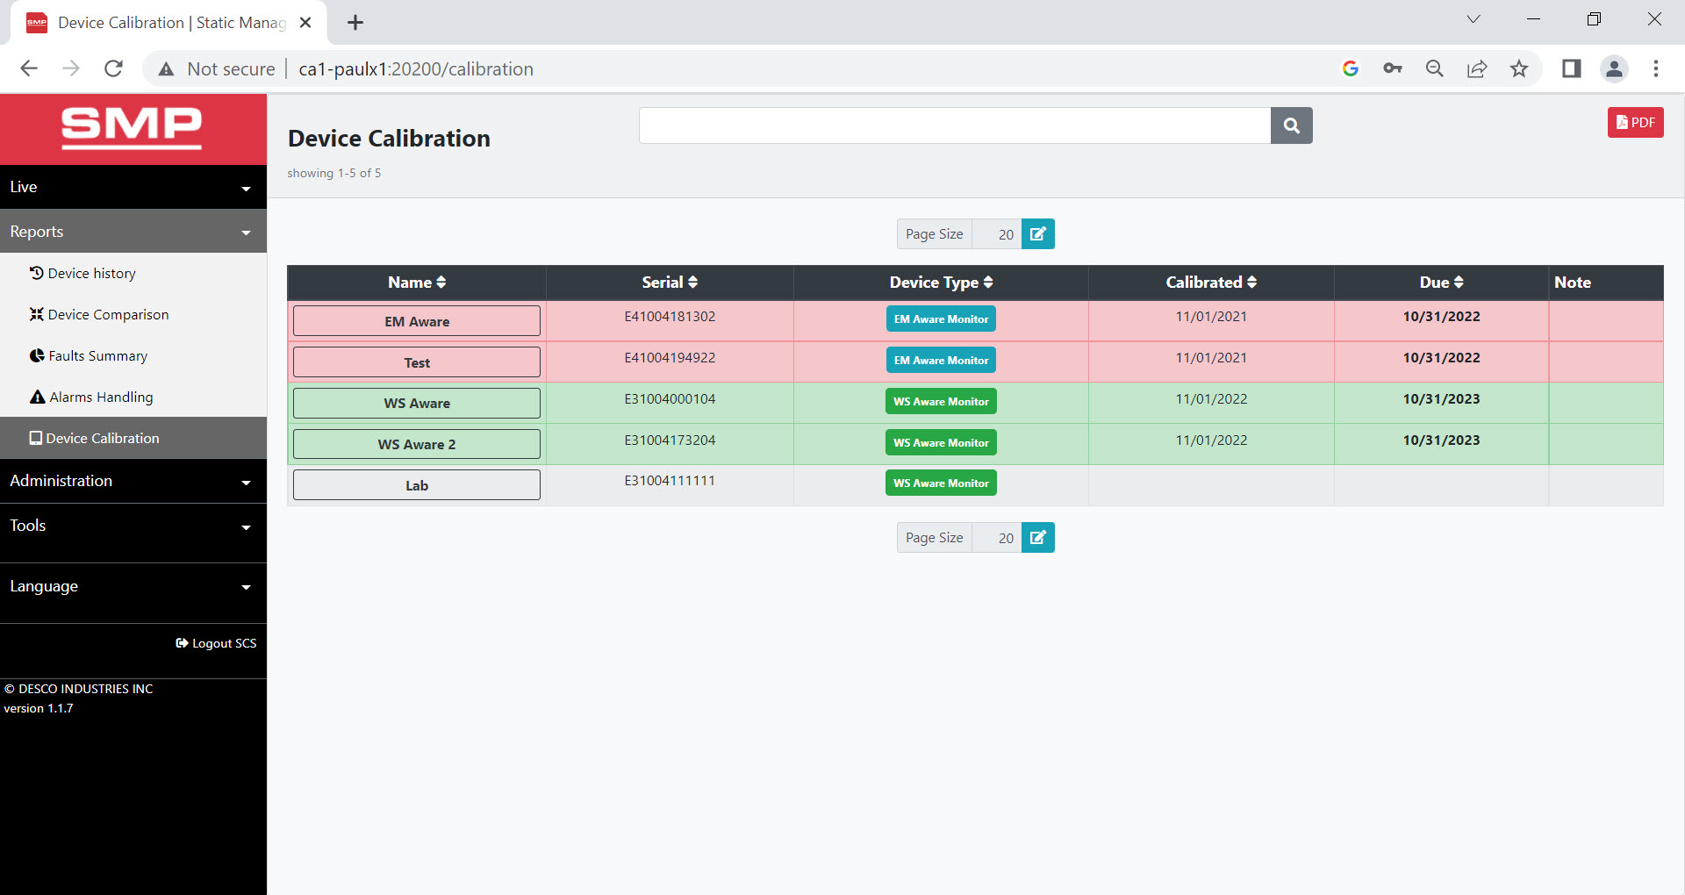
CALIBRATION
Colour coded monitor statuses help identify which are within or out of calibration
DescoEurope.com

Slide 19

WHAT IS THE PAYBACK?
Instead of spending money on just prevention, not knowing if products are protected, and unable to determine payback…
Companies can now determine and measure their ROI
Savings may be realised from:
  Higher yields & process efficiencies
  Elimination of costly inspections
  Fewer customer complaints
  Less re-work and lower field returns
  Budgets driven by performance data
Leverage SMP to attract and retain customers
  New source of competitive advantage
  Tip the scale in project negotiations
DescoEurope.com

Slide 20



CONTACT US
For more information, please visit:
DescoEurope.com
2A Dunhams Lane
Letchworth Garden City
Hertfordshire, SG6 1BE, UK
Phone: +44 (0) 1462 672005
Fax: +44 (0) 1462 670440
Email: Service@DescoEurope.com

