Slide 1
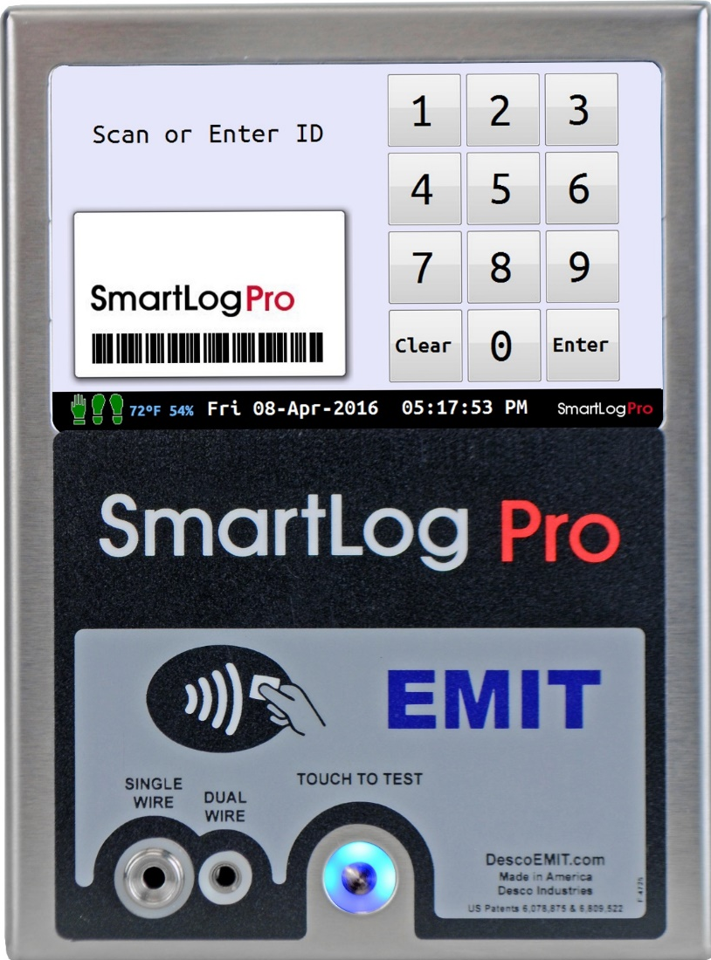
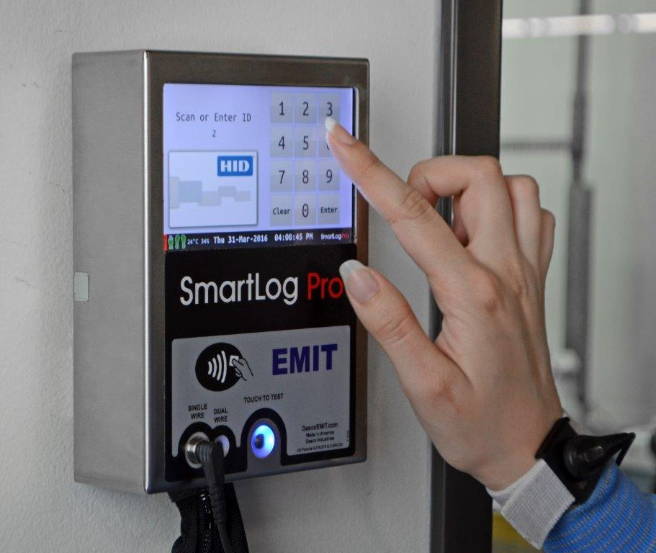
ESD RESULTS AT YOUR FINGERTIPS
DescoEurope.com

Slide 2
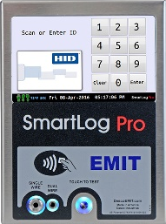
OVERVIEW
Networked Communication
Email / Web Reporting
Electronic Documentation
The SmartLog Pro™ verifies the functionality of an operator’s wrist strap and footwear, logs the test record, and can control access to an ESD Protected Area.
All operator test activity is logged into a database to meet the EN 61340-5-1 requirement for “Compliance verification records shall be established and maintained” and for on-going quality control purposes.
Each log entry includes operator identification, test results, resistance measurements, time, temperature and humidity.
Operator identification and access control is performed using the embedded HID OMNIKEY® proximity reader, barcode reader or touchscreen keypad.
Access control to an ESD Protected Area can be further enforced by using the relay terminal on the SmartLog Pro™. It can be connected to an electronic door lock or turnstile to grant access only to those who have passed their pre-defined personnel grounding tests.
EMIT

Slide 3
WHY DATA ACQUSITION?
Paperless data can enhance operator accountability, immediately identifying problems while reducing logging and auditing costs. Paper log systems have proven to be inaccurate and ignored over time. Paper log systems are also limited to what information is documented and poses the following questions:
Do your paper logs show any failures?
If a Pass entry is logged, do you know that the test was actually made?
If a Pass entry is logged, do you know who actually made the entry?
If a Pass entry is logged, do you know if they failed previously?
How many failed tests were conducted prior to the written passed result?
If no entry is logged, do you know if the person worked that day?
Is calibration of each tester tracked on the same paper log?
Do you keep track of smock and ESD footwear testing?
Are pass entries logged for future days?
Do your paper logs identify the type of test performed per operator?
EMIT

Slide 4
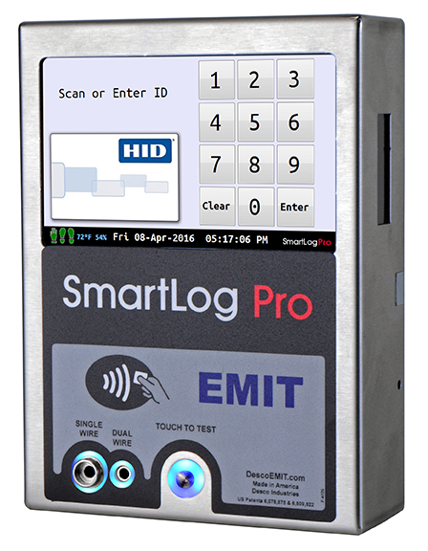
HARDWARE FEATURES
5 Inch Colour Touchscreen Display
Single-Wire and Dual-Wire Wrist Strap Testing
ESD Footwear Testing (Foot Grounders or Shoes)
Static Control Smock and Glove Testing
Barcode and Proximity Readers
Ethernet Module for Network Communication
Dual Foot Plate for Independent Footwear Testing
30V Test Voltage for Increased Accuracy
Simultaneous Testing of the Worn Wrist Strap and Footwear in Less than 2 Seconds
EMIT

Slide 5
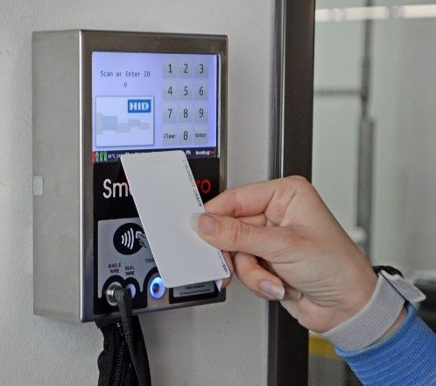
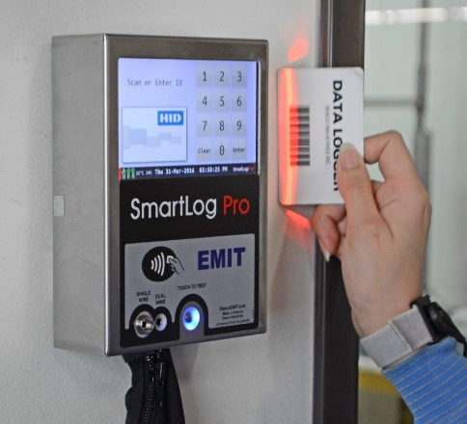
Embedded HID OMNIKEY® Proximity Reader
iCLASS® and HID Prox® ready
Programmable with most proximity badge formats
Embedded CCD barcode scanner
Reads code 39 and 128
Programmable with most barcode badge symbologies
9 digit numeric keypad
Alternative operator identification if barcode/proximity card misplaced
Can be disabled to enforce barcode/proximity scanning
EMIT

Slide 6
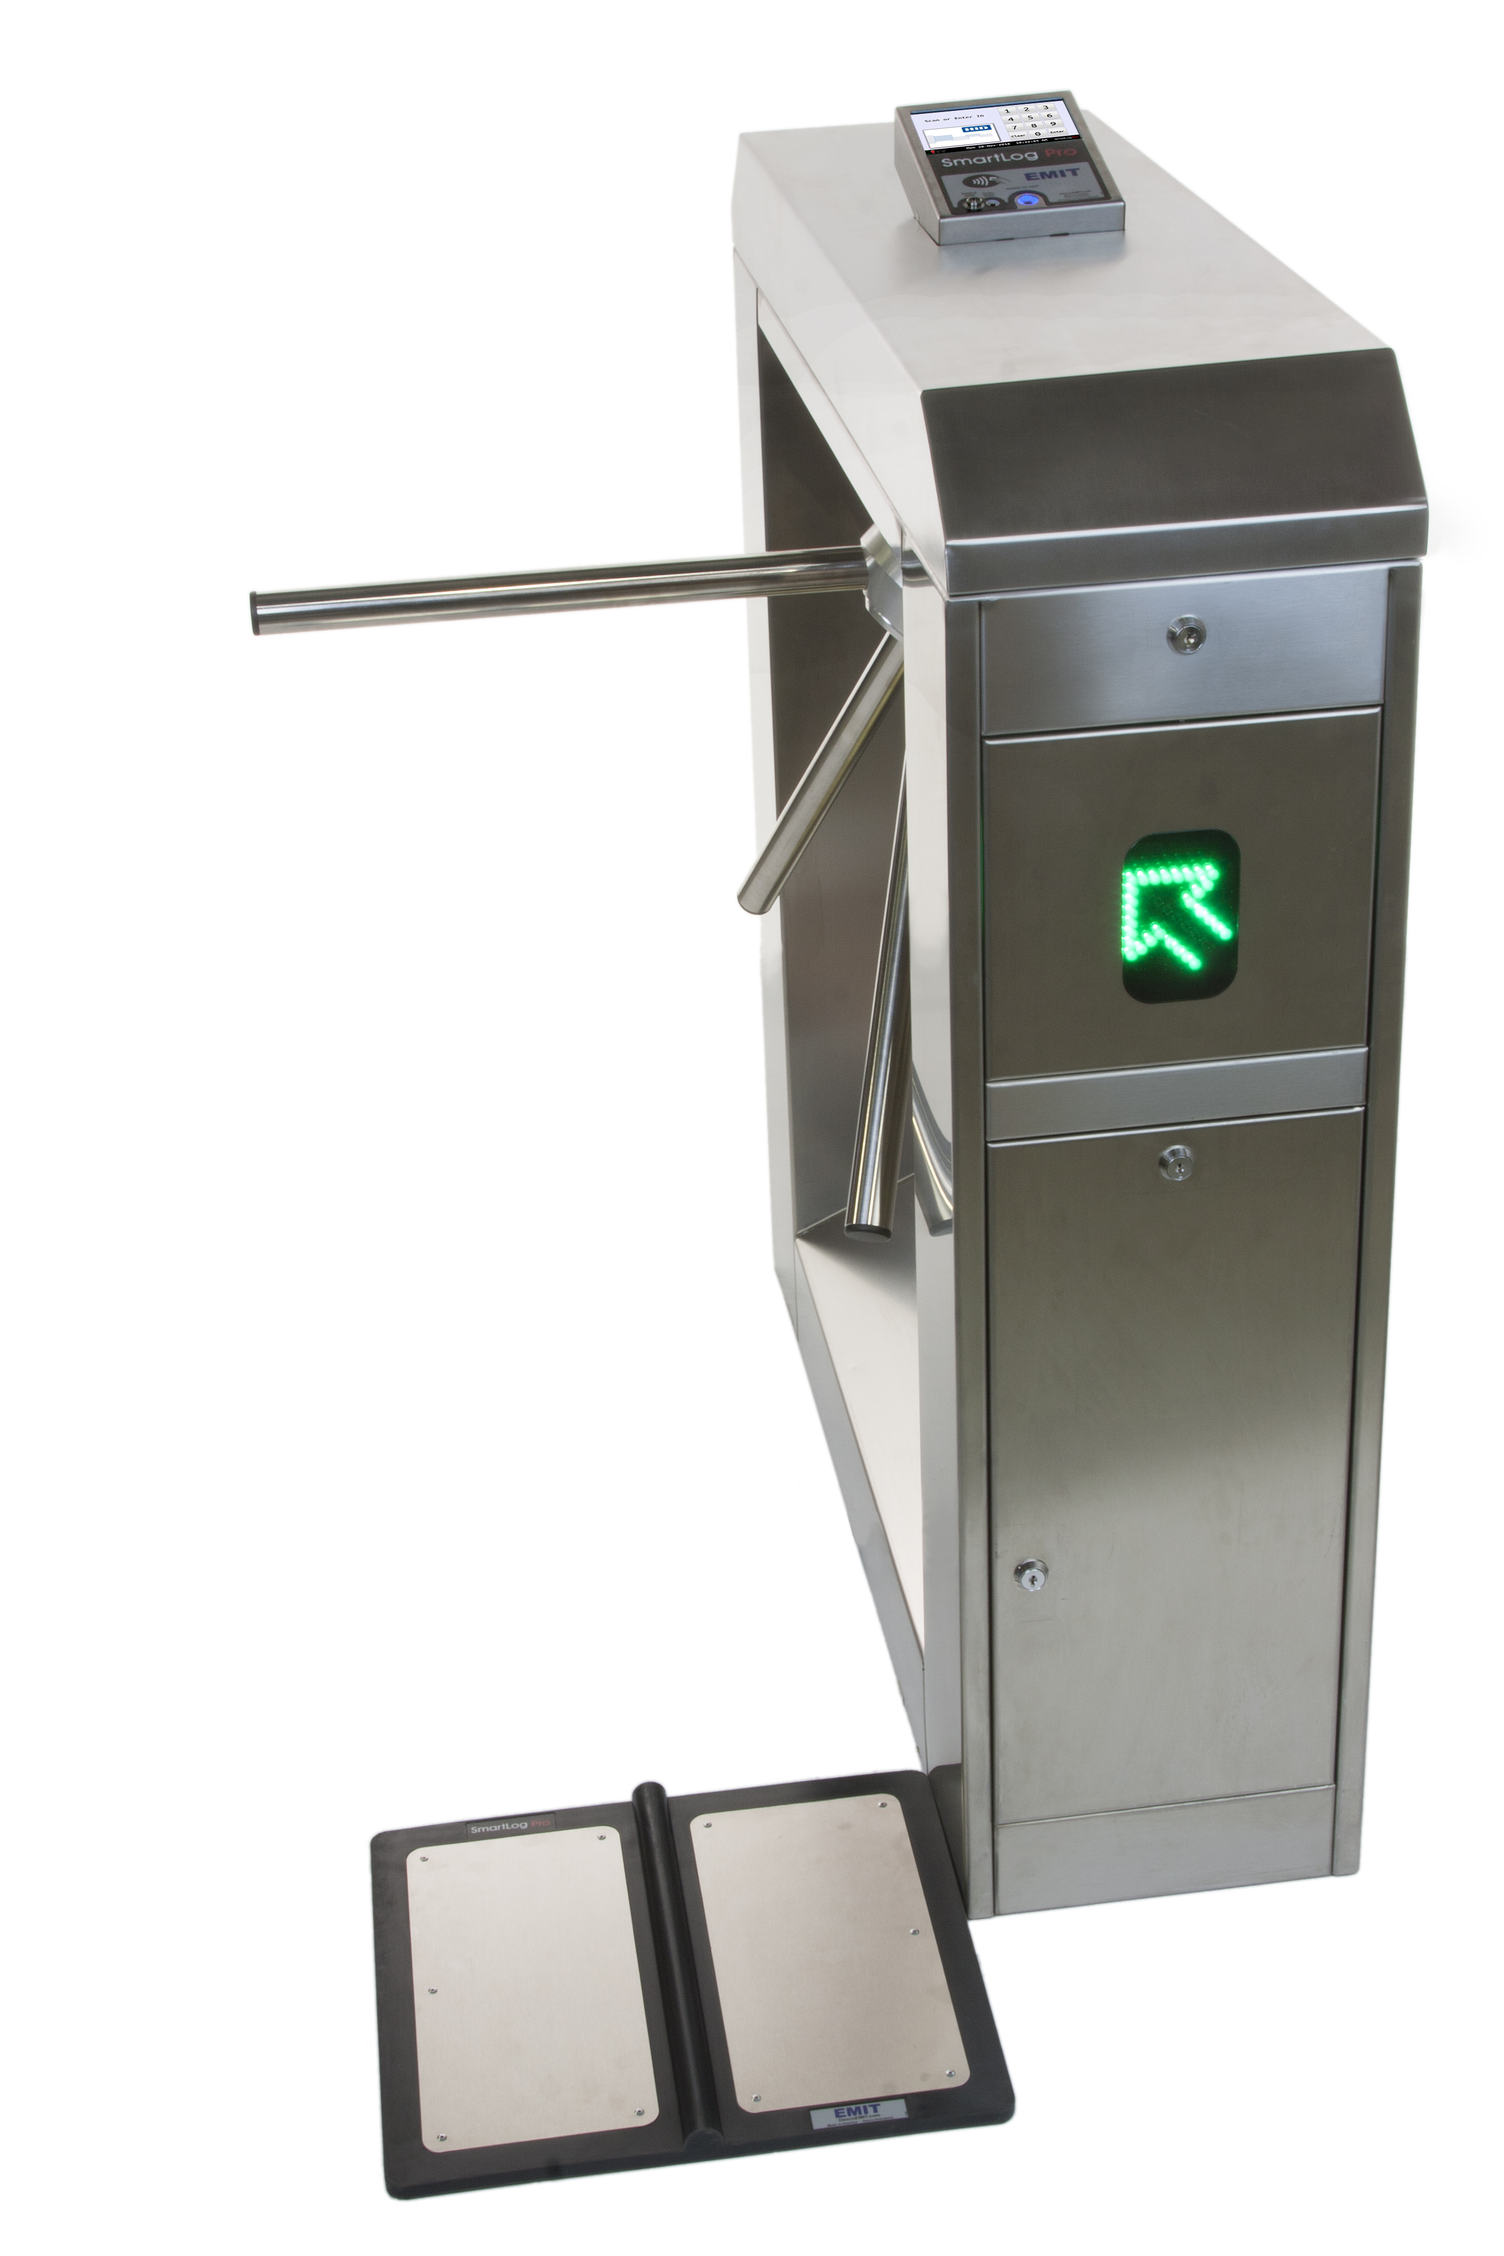
Embedded Ethernet Module
Networked Communication to a desktop PC or Server
Configurable to a Dynamic or Static IP address
Built-in Setup Utility
Embedded Relay Terminal
Normally Open and Closed Relay Terminals
Compatible with a Light Tower or Magnetic Door Switch
Complete Turnstile package available
EMIT

Slide 7
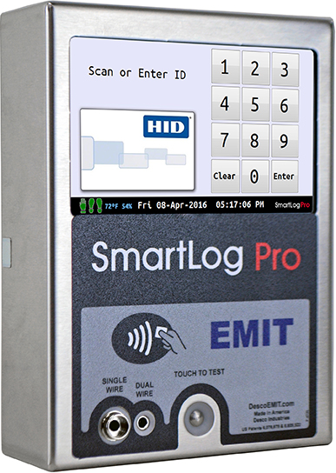
TESTER SOFTWARE FEATURES
Records Temperature and Relative Humidity
Records Resistance Measurements
Displays Operator’s First and Last Name
Displays Operator’s Test Requirement
Colour Coded Pass / Fail Results
Programmable Resistance Limits
Access Control Capabilities
Records In and Out Transactions
Time Clock Capabilities
Records Punch In and Punch Out Transactions
EMIT

Slide 8
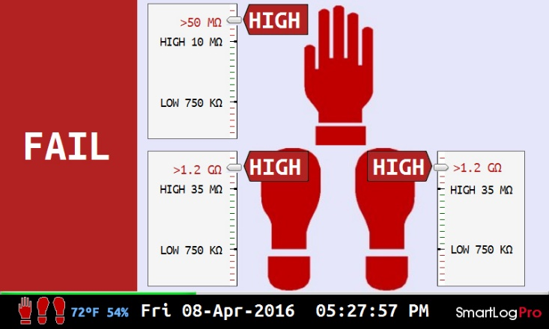
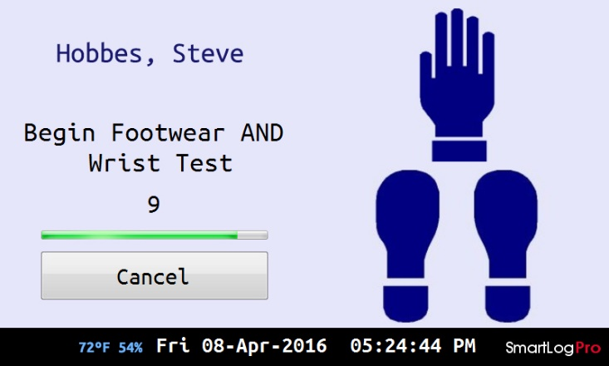
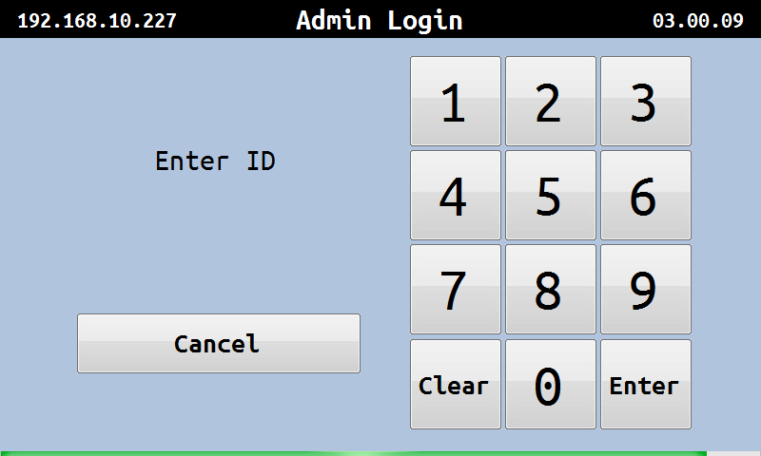
Records results for each wire of a dual-wire wrist strap
Records results for the left and right footwear
Wrist / Foot and other test requirements are available
Wrist / Foot symbols make it easy for operators to identify which test to perform
Password protection eliminates operators from manipulating test settings
All changes are recorded and viewed through the server software
EMIT

Slide 9
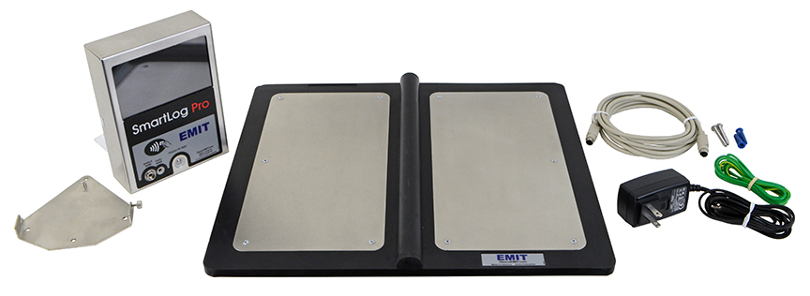
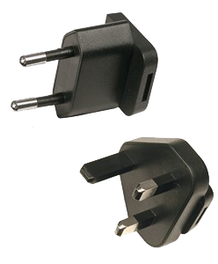
SPECIFICATIONS
Stainless Steel Enclosure (17.1cm x 12.7cm x 4.4cm)
127mm Colour Touchscreen
Motorola CCD Barcode Scanner
HID OMNIKEY® Proximity Reader
Single-Wire Banana Jack
Dual-Wire Mono Jack
2 USB Ports
Ethernet Port
Foot Plate Port
Relay Terminal
Ground Jack
5VDC Power Jack
EMIT

Slide 10
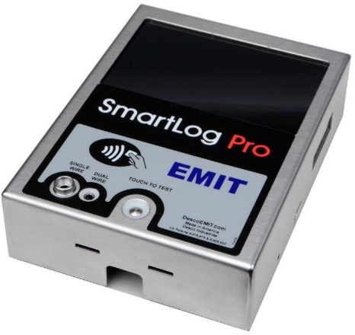
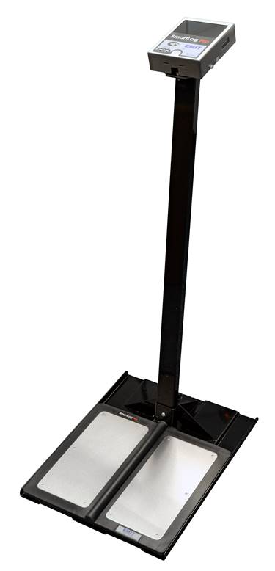
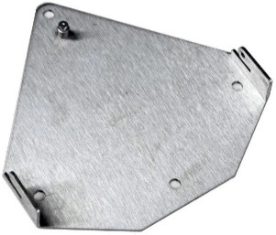
MOUNTING OPTIONS
Stand
Use the EMIT 50415 stand as an alternative method to mounting the SmartLog Pro™ on a wall. It features a heavy gauge, powder-coated steel construction for minimised corrosion and contamination.
Wall Mount
The new mounting bracket allows the unit to be mounted and removed without the use of any tools. Install the bracket to a flat surface and secure the SmartLog Pro™ with the included thumbscrew.
EMIT

Slide 11
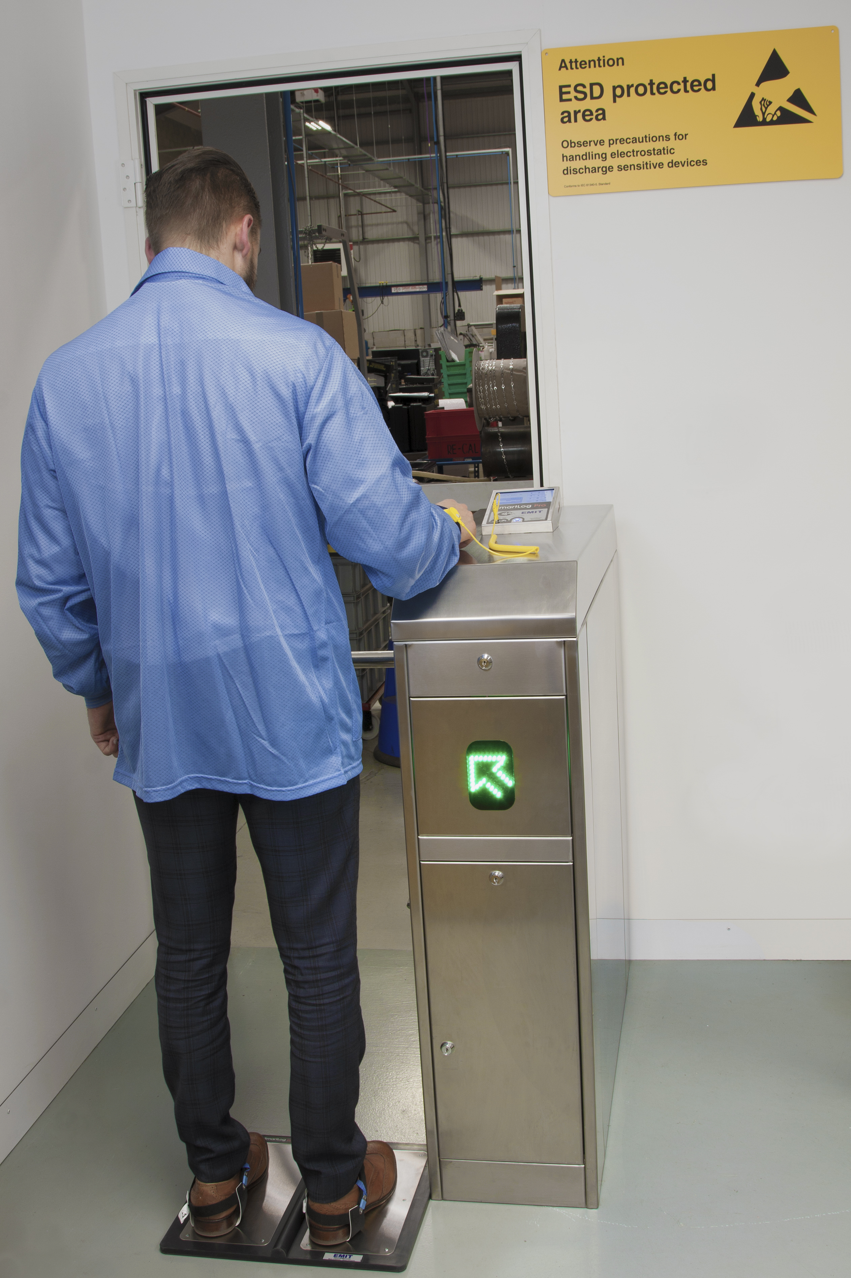
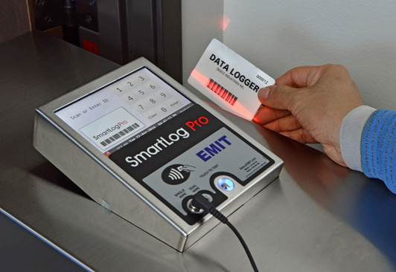
EPA ACCESS CONTROL
Complete system includes EMIT SmartLog Pro™ with Turnstile
Controls access to ESD Protected Areas
Ensures single operator pass through; auto relock feature
Bi-directional; enter and exit through the same turnstile
Free passage for emergencies or loss of power
Made in the United States of America
EMIT

Slide 12
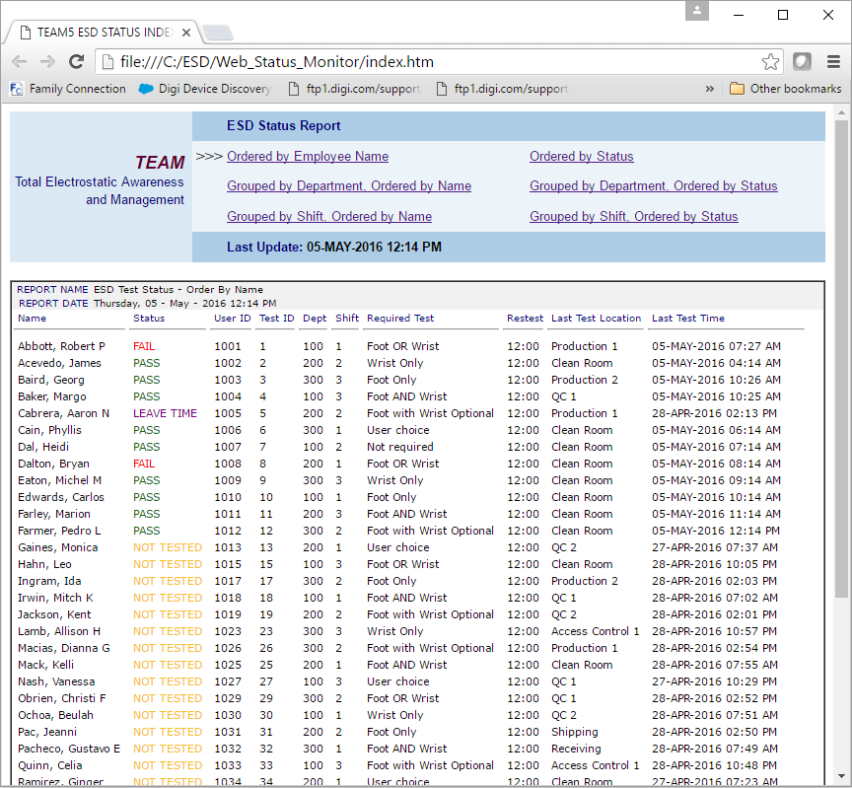
TEAM SOFTWARE FEATURES
Compatible with all Windows Operating Systems
Desktop and Server Install Packages Available
Monitors the Activity of all Operators and Test Machines
ESD Status Reports Available by Email or Web
Data Synchronisation Between Personnel Databases
Emailed Notifications of Software or Operator Failures
Technical Support Agreement Included
EMIT

Slide 13
REQUEST A DEMO TODAY!
EMIT

Slide 14
For More Information Please Visit
DescoEurope.com

