Slide 1
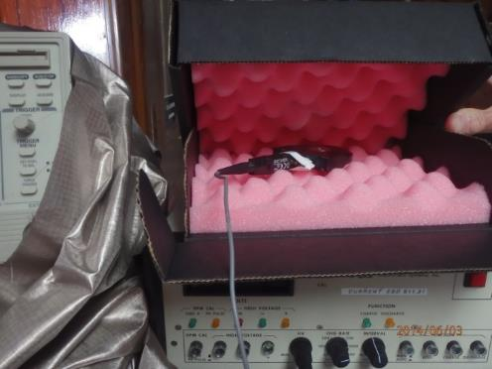
ESD Tests on Conductive Coated
Versus Protektive Pak
Impregnated Corrugated Boxes
Fowler Associates, Inc.
3551 Moore-Duncan Hwy. Moore, SC 29369
Tel: 864-574-6415 FAX: 864-576-4992 Email: sfowler@sfowler.com
Steve Fowler Biography

Slide 2
The purpose of these tests and report is to determine the effective shielding of Coated conductive ESD boxes versus Protektive Pak impregnated corrugated boxes.
This report will determine the level of resistance in the Protektive Pak box’s buried carbon layer.

Slide 3
Buried Conductive layer using
Silver Electrodes = 9.2 x 10³ ohms

Slide 4
Buried Conductive layers can be at times difficult to measure.
The test methods used to measure the conductive layer result in a varied yet narrow range of values.
The results confirm that the buried conductive layer of the Protektive Pak impregnated corrugated box is within the 10³ ohms range.
The test proves Protektive Pak Impregnated Corrugated boxes meet the resistance and shielding requirements of Packaging standard ANSI/ESD S541.

Slide 5
Electrode in normal Product Position
in the Middle of the Box

Slide 6
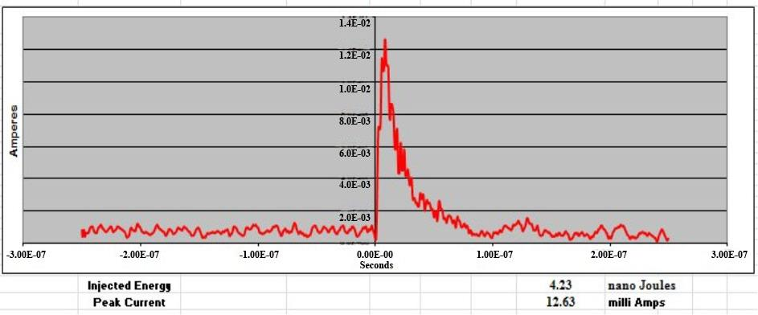
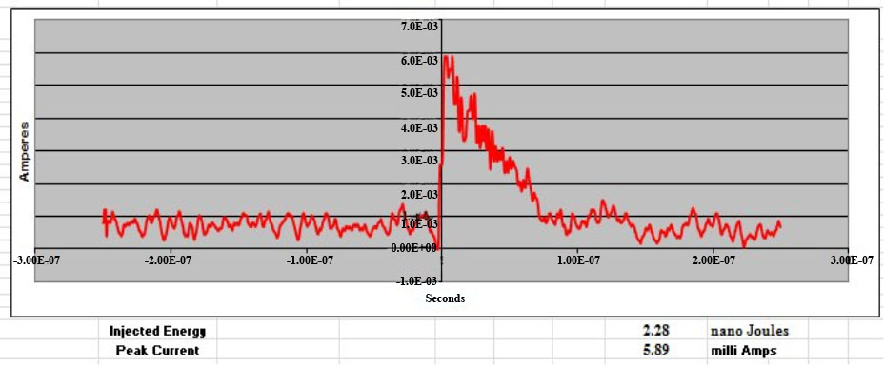
Coated Box with 1000 volt HBM
Discharge and Electrode in
Product Position in the Middle
of the Box.
Protektive Pak Box with
1000 volt HBM Discharge
and Electrode in Product Position
in the Middle of the Box.

Slide 7
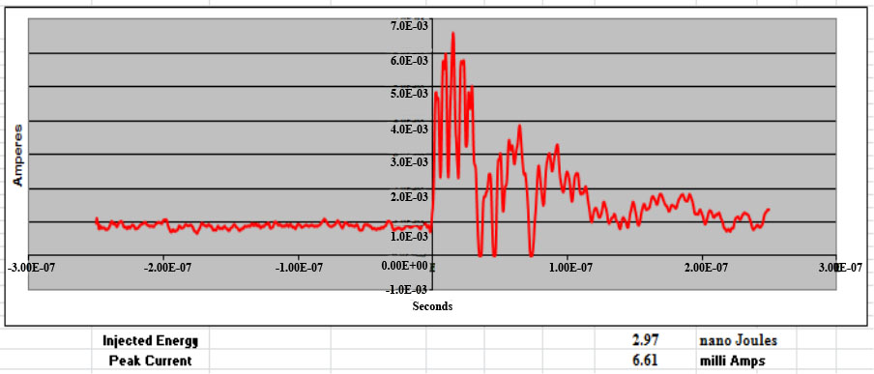
Nickel Metal Bag with
1000 volt HBM Discharge
and Electrode in normal Product Position
in the Middle of bag.

Slide 8
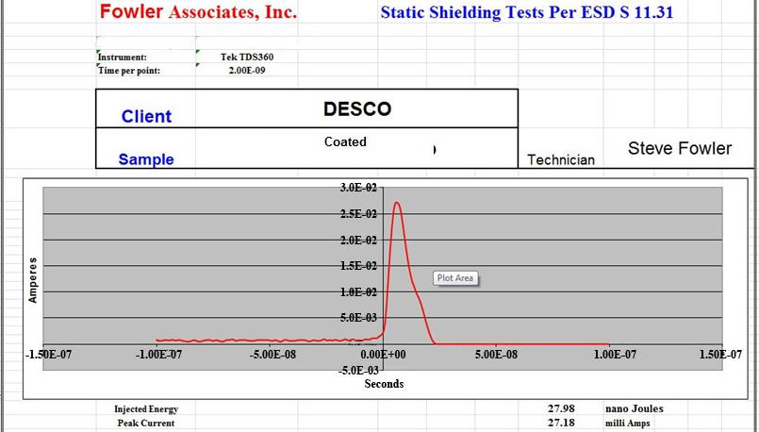
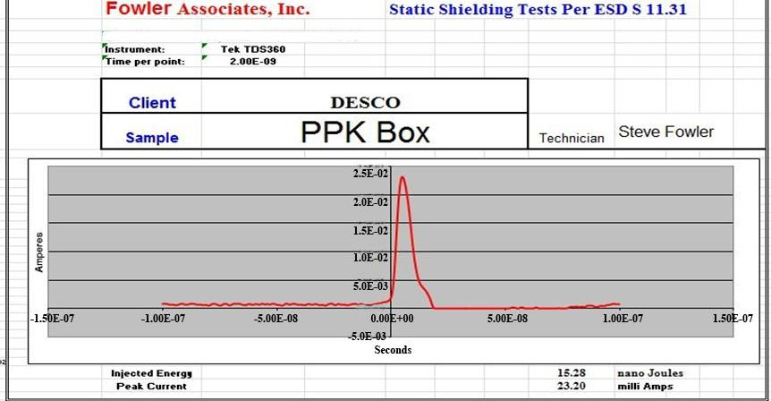
10 kilovolt HBM with Electrode near top inside of Box Coated = 27.98 nanoJoules
10 kilovolt HBM with Electrode near top inside of Box Protektive Pak = 15.28 nanoJoules

Slide 9
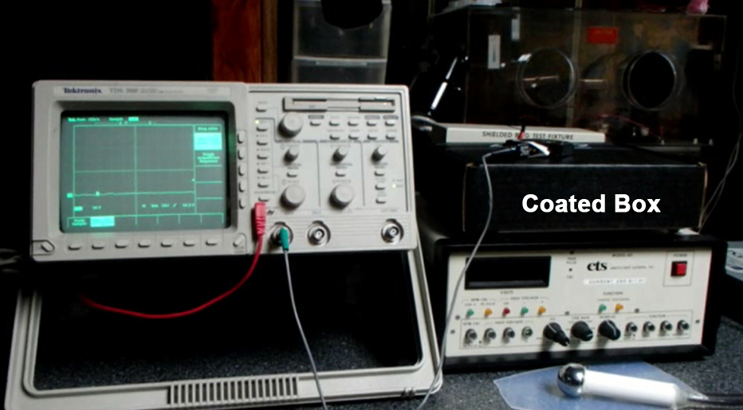
Conductive Coated Box
10 kilovolt HBM Electrode on Top of Box

Slide 10
Protektive Pak Impregnated Corrugated Box
10 kilovolt HBM Electrode on Top of Box

Slide 11
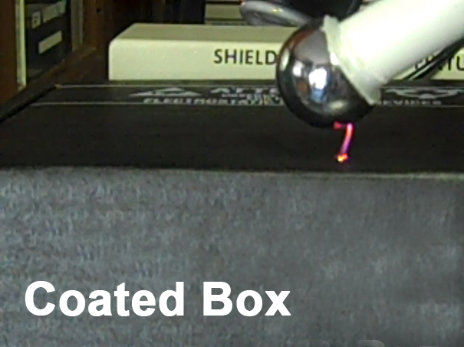
Conductive Coated Box –
10 kilovolt Plasma on Top of Box

Slide 12
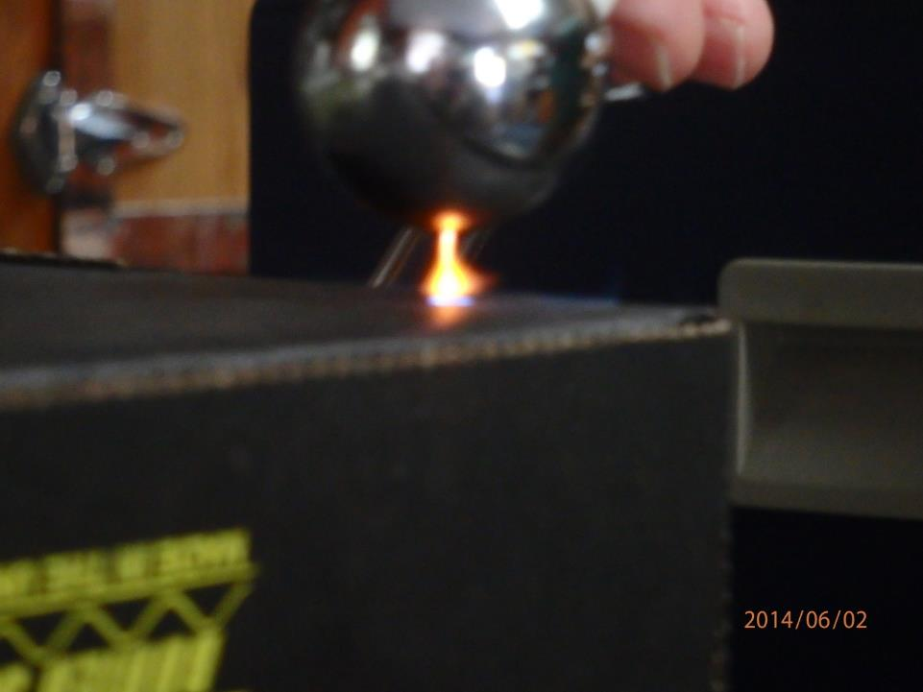
Protektive Pak Impregnated Corrugated Box
10 kilovolt Plasma on Top of Box

Slide 13
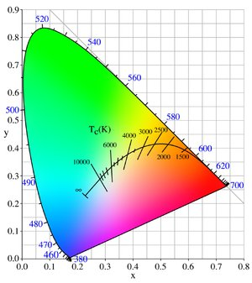
Difference of Plasma
Conductive Coated has a temperature of > 10,000 Degrees
Protektive Pak Box has only between 2,500-3,000 degrees
indicating the conductive coated box results in a higher energy of discharge to the surface due to high conductivity thus higher damage to parts on the box.

Slide 14
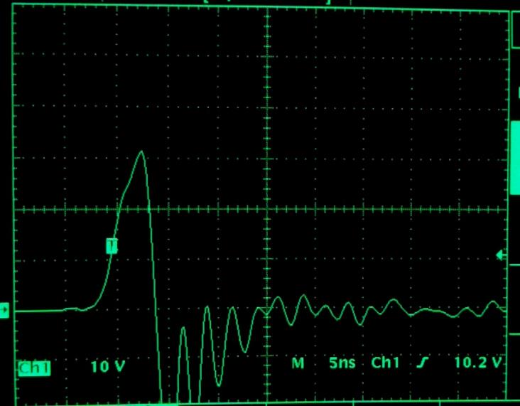
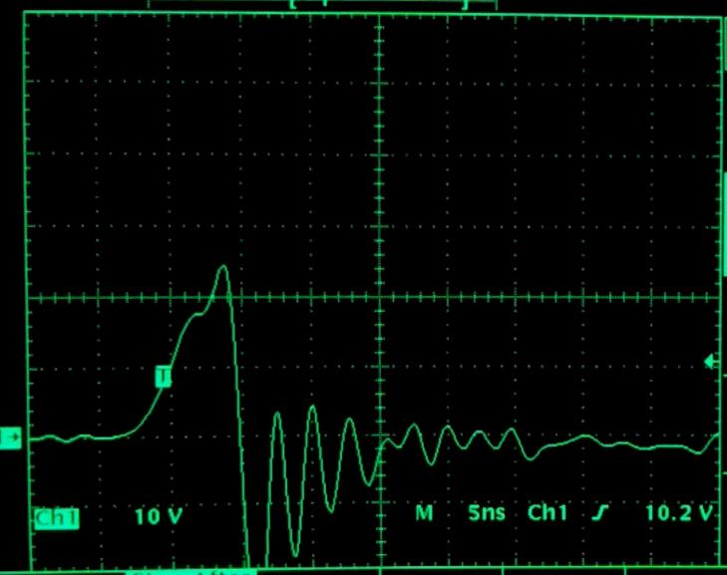
Conductive Coated vs. Protektive Pak
10 kilovolt HBM to Electrode on Top of Box
Simulating a Product being Placed
on the Box After Handling

Slide 15
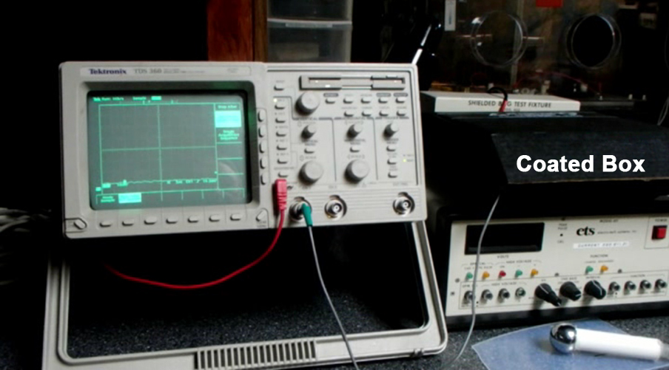
Conductive Coated 10 kilovolt HBM
Electrode in Middle Demo

Slide 16
Protektive Pak Impregnated Corrugated
10 kilovolt HBM Electrode in Middle Demo

Slide 17
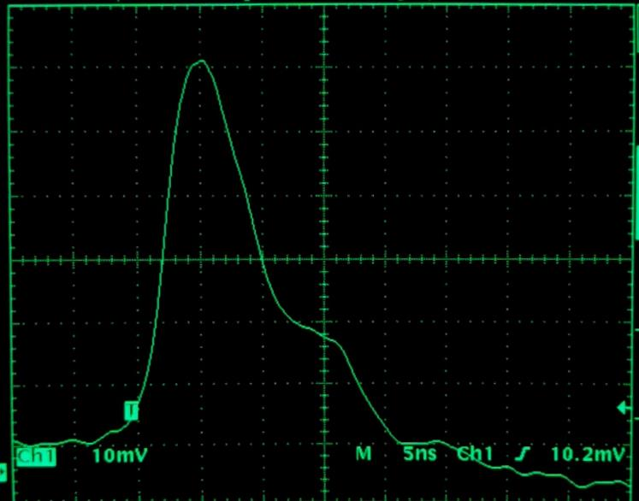
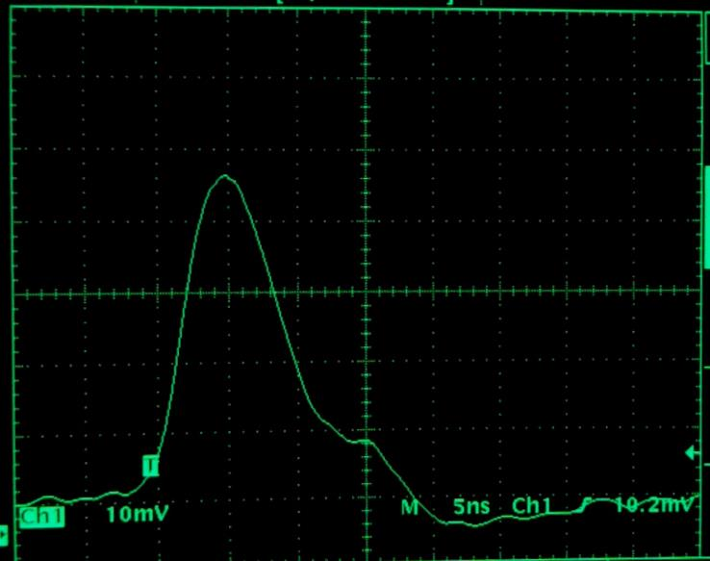
Conductive Coated vs. Protektive Pak
10 kilovolt HBM to Electrode In Middle
of the Box Simulating Energy at Box Contents

Slide 18
Conclusions
The Protektive Pak impregnated corrugated box has a conductive buried layer in the order of 10³ ohms. This has been proven by these tests.
The Protektive Pak box is superior to the discharge shielding capabilities of the coated boxes.
Energy penetration 2.28 versus 4.23 nanoJoules.
The Protektive Pak box has discharge shielding capabilities equal to a highly conductive metal-out shielding bag.
Energy penetration of 2.28 versus 2.97 nanoJoules.
The ESD Association in its Packaging ANSI/ESD S541 Standard sets a required limit of less than 50 nanoJoules.

Slide 19
Conclusions
The Protektive Pak impregnated corrugated box with its dissipative surface minimizes the levels of energy discharged to a product resting on top of the box.
Most ESD Experts state that any surface which a product may contact must be dissipative NOT conductive. (Ref: ANSI/ESD S541 section 7.2.2)
Conductive surfaces lead to energetic discharges that may damage ESD sensitive items in all models including Charged Device Model (CDM).
Protektive Pak Impregnated Corrugated boxes meet discharge shielding requirements of Packaging standard ANSI/ESD S541, and dissipative resistance recommendation 1 x 10⁴ to < 1 x 10¹¹ ohms.

