Slide 1





EBP Continuous Monitor
The Specialists in ESD Protection
Item 222606
Item 222607
- UK Plug
- Euro Plug
Use to verify grounding of Earth Bonding Points [EBP] and Common Ground Points.
Made in the
United States of America
Vermason.co.uk

Slide 2


EBP Continuous Monitor
The Specialists in ESD Protection
Primary Function:
Continuously monitors the path to ground integrity of the electrical outlet
Standards Requirement:
Per EN 61340-5-1 "the first and preferred ESD ground is protective earth if available. In this case, the ESD control elements and grounded personnel are connected to protective earth"
Made in the
United States of America
Vermason.co.uk

Slide 3

EBP Continuous Monitor
The Specialists in ESD Protection
Constant Visual Indicator:
GREEN LED indicates proper wiring of electrical outlet and path to ground
Made in the
United States of America
Vermason.co.uk

Slide 4
EBP Continuous Monitor
The Specialists in ESD Protection
Visual and Audio Fault Alarms:
RED LED and Audio Alarm activate when there is a failure.
Made in the
United States of America
Vermason.co.uk

Slide 5

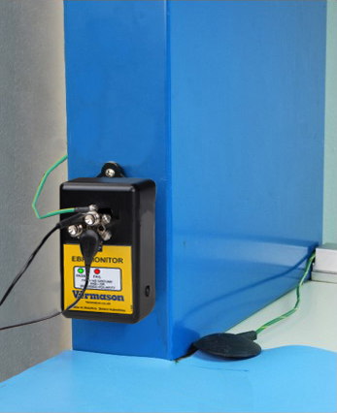

EBP Continuous Monitor
The Specialists in ESD Protection
Six Banana Jacks and Three 10mm Snap Adapters, Six Screws for #8 Ring Terminals
Made in the
United States of America
Vermason.co.uk

Slide 6


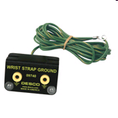
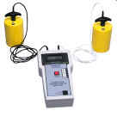
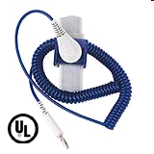
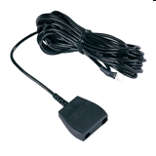
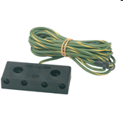
EBP Continuous Monitor
The Specialists in ESD Protection
Connect to Other Grounding Products
Made in the
United States of America
Vermason.co.uk

Slide 7
EBP Continuous Monitor
The Specialists in ESD Protection
Target Customers:
Workstations without monitors
Workstations with multiple grounding applications
Workstations where the ground connection is not visible to the operator
Made in the
United States of America
Vermason.co.uk

Slide 8


EBP Continuous Monitor
The Specialists in ESD Protection
Part# 222606 - UK Plug
List Price: £127.25
Part# 222607 – Euro Plug
List Price: £157.33
Made in the
United States of America
Vermason.co.uk

Slide 9
Our Commitment
The Specialists in ESD Protection
Got ESD?
We are the longest established ESD control
company in the UK.
We will provide solutions, solve
problems, educate.
We will help you comply to
industry standards for ESD control.
We are the Specialists in ESD Protection!
Vermason.co.uk

Slide 10
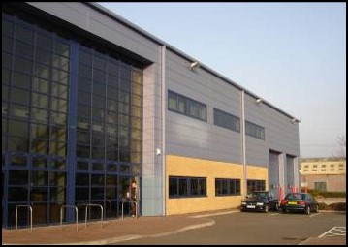
Our Location
The Specialists in ESD Protection
Come Visit Us!
Unit C
4th Dimension
Fourth Avenue
Letchworth, Hertfordshire, SG6 2TD
United Kingdom
Phone: +44 (0)1462 672005
Fax: +44 (0)1462 670440
Email: Service@Vermason.co.uk
Web: Vermason.co.uk

