Slide 1
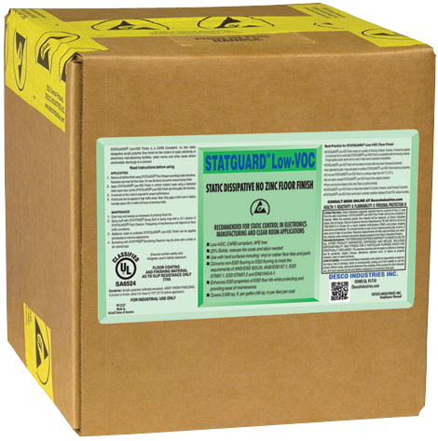
Statguard® Low-VOC Floor Finish
Part # 220528
19 Liters
© 2017 Desco Europe

Slide 2
Statguard® Low-VOC
Primary Function:
Used to
Convert hard non-ESD floors to ESD protective flooring
Protect and enhance ESD permanent flooring (vinyl, VCT, rubber)
DescoEurope.com

Slide 3
Statguard® Low-VOC
Standards Requirement:
Dissipative (10⁷ - 10⁹ ohms) Coating
Meets EN 61340-5-1 flooring required limit Rg 1 x 10⁷ to < 1 x 10⁹ ohms per IEC 61340-4-1 at 50% RH
Low Tribocharging (<100 volts) Coating Tested per IEC 61340-4-5
Easily meets EN 61340-5-1 person/footwear/flooring limit for peak body voltage.
Made in the
United States of America
DescoEurope.com

Slide 4
Statguard® Low-VOC
What are VOC’s?
Volatile Organic Compounds
– usually found as part of chemical products
(like Floor Finish)
– they can evaporate into the environment.
Who sets the guidelines for VOC’s?
Regions can tighten up the Nation’s requirements, but
not relax the requirements.
Made in the
United States of America
DescoEurope.com

Slide 5
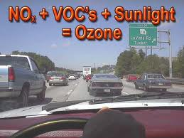
Statguard® Low-VOC
What harm/issues do VOC’s cause our customers?
Production of ozone
VOCs have been found to be a major contributing factor to the production of ozone, a common air pollutant.
This is why governments are limiting their use.
Made in the
United States of America
DescoEurope.com

Slide 6
Statguard® Low-VOC
What harm/issues do VOC’s cause our customers?
Production of ozone
Personal discomfort
Standard ESD Floor Finish if not ventilated properly can cause personal discomfort as well as unpleasant odor.
Statguard® Low-VOC reduces any odor and possible personal discomfort from VOC’s
Made in the
United States of America
DescoEurope.com

Slide 7
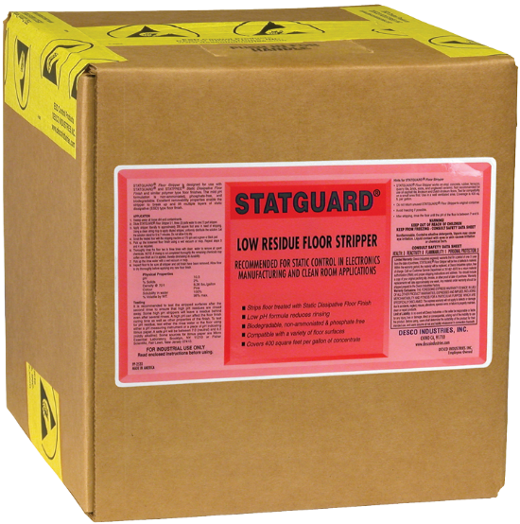
Statguard® Low-VOC
Do Statguard® Stripper and Floor Cleaner Meet VOC requirements:
Yes
Each product category has its own requirements, and both the Stripper and Floor Cleaner meet those requirements.
Made in the
United States of America
DescoEurope.com

Slide 8
Statguard® Low-VOC
Comparison between standard Statguard Floor Finish and Low-VOC Floor Finish :
Statguard Floor Finish – 18% solids
Low-VOC Floor Finish – 23% solids
27% more solids in Low-VOC Floor Finish
Benefits to End User
Less material used
Reduced labor costs
When a scrub/recoat is required, the
Low-VOC recoat will last longer
Made in the
United States of America
DescoEurope.com

Slide 9
Statguard® Low-VOC
Does the Low-VOC product contain zinc?
No
Benefit – Meets waste water treatment guidelines for heavy metals when applicable.
Made in the
United States of America
DescoEurope.com

Slide 10
Statguard® Low-VOC
Is this a Low-VOC product or a No VOC Product
Low VOC
There is a small amount of VOC’s, but they are exempt from some requirements.
We COULD call it a No-VOC product from a regulatory standpoint, but we choose not to in order to avoid confusion, misconceptions.
Made in the
United States of America
DescoEurope.com

Slide 11
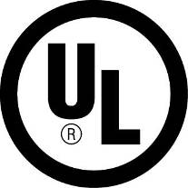
Statguard® Low-VOC
Part # 220528 - 19 Liters
List Price: £120.46
Made in the
United States of America
DescoEurope.com

Slide 12
Our Commitment
Got ESD? We are the longest established ESD control
company in the UK. We will provide solutions, solve problems, educate. We will help you comply to industry standards for ESD control. We are the Specialists in ESD Protection!
DescoEurope.com

Slide 13
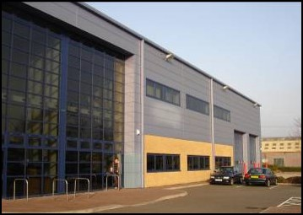
Our Location
Come Visit Us!
Unit C 4th Dimension Fourth Avenue Letchworth, Hertfordshire, SG6 2TD United Kingdom
Phone: +44 (0)1462 672005 Fax: +44 (0)1462 670440
Email: Service@DescoEurope.com Web: DescoEurope.com

